Slide 1


CRVS Legal Framework Review
Fiji Islands

Slide 2
Overview
Implementation of the Regional Action Framework
Progress towards CRVS legal framework
Challenges encountered
Opportunities

Slide 3
CRVS Regional Action Framework towards the CRVS Legislations
facilitate collaborative action by multiple stakeholders
  Goal 1
      Achieve at least 85 % registration of all births that occur in a given year
      Health sector to record all deaths with a medically certified cause of death in a given year
    Goal 2
      Issuance of an official birth/death certificate that includes, as a minimum, the individual’s name, sex, date and place of birth, and name of parent(s) where known.
  Goal 3
      100% dissemination of annual nationally representative statistics on deaths that have an underlying cause of death code derived from the medical certificate according to the standards defined by ICD (latest version as appropriate)
      Summary tabulations of vital statistics on births and deaths using registration records as the primary source, are made available in the public domain in electronic format annually, and within one calendar year.
Notes:
Point 1:
- (i.e. CRVS partners) to align and prioritize their efforts, as well as to monitor progress through achieving the 3 major goals/national targets.
-

Slide 4
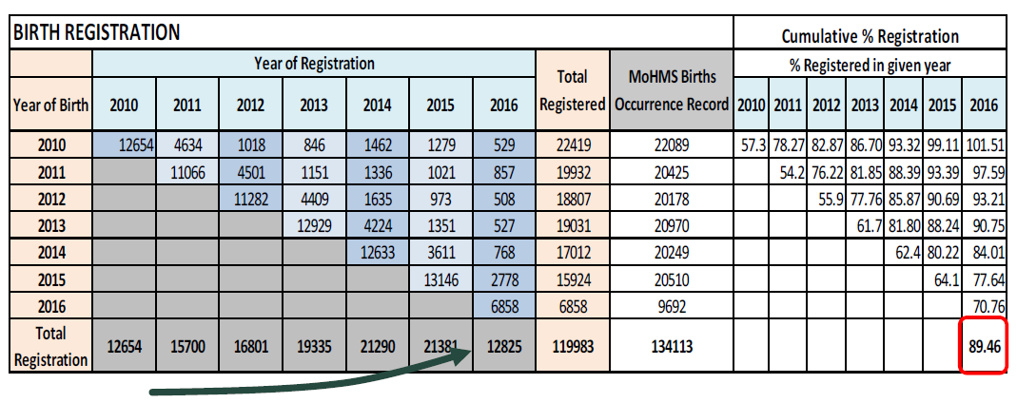
Progress Status towards the establishment of CRVS Legislations
Registration Coverage

Slide 5
Progress Status cont’d
Official documentation of community births and deaths
Provisions allocated for services where there were no registry offices
Awareness of health professionals to ensure data entry of birth and deaths into the National Health Information System (NHIS)
Active collaboration of the CRVS partners for data sharing and analysis

Slide 6
Challenges (towards the CRVS Legal Framework)
Formalising the CRVS Committee
Establishment of the CRVS
Amendment of Legislation(BDM Act)
National CRVS Strategy Development for Fiji
Support for trainings to accurately document the vital events.
Notes:
Point 1: as the regulatory and monitoring body for vital statistics
Point 2: not a top priority for government therefore steps towards establishing the CRVS has been delayed
Point 3: there hasn’t been any amendments of the BDM act, no definitions of the vital events

Slide 7
Opportunities
Awareness of Doctors and Nurses of the correct documentation of birth and death
Collaboration of the CRVS partners through continuous data sharing
Improvement in coverage and registration
Address data gaps and quality issues for analysis from the Ministry of Health and Registrar General’s Office

Slide 8
Thank you

