Slide 1
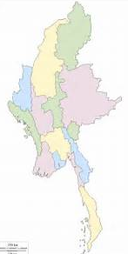
Analyzing national arrangements and practices
Myanmar
Ms Khin Moe Moe
Director
Central Statistics Organization
Ministry of Planning and Finance

Slide 2
Main obstacles for
improving accuracy of registered information

Slide 3
Supply and Demand sides
Lack of community awareness on the importance of registration;
Improving service linkages;
Limited manpower;
Law on CRVS and CRG inclusive
of budget allocations, other needful,

Slide 4
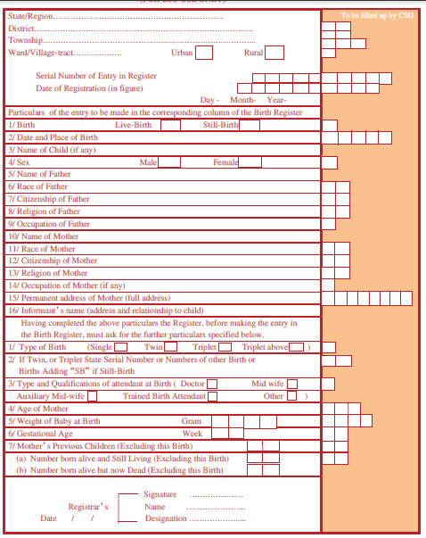
Birth Registration Form
Core:
Data of occurrence
Date of registration
Place of occurrence
Place of registration
Type of birth
Attendant at birth
Sex
Weight at birth
Data of birth (mother)
Marital status
Education attainment
Place of usual residence
Duration of residence in usual place
Place/country of birth
Children born alive to mother during her entire lifetime
Foetal deaths to mother during her entire lifetime
Date of last previous live birth
Data of marriage
Data of birth (father)
Marital status
Education attainment
Place of usual residence
Existing BR Form

Slide 5
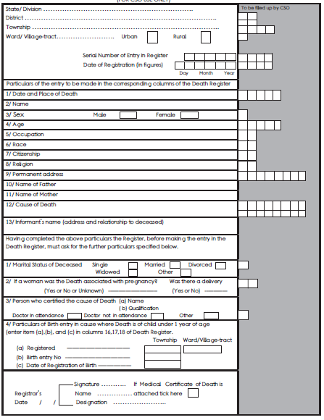
Death Registration Form
Core
Data of occurrence
Date of registration
Place of occurrence
Place of registration
Cause of death
Certifier
Sex
Date of birth
Sex
Marital status
Place of usual residence
Existing DR Form

Slide 6
Team conclusion
80% close to core

Slide 7
Key challenges to improve coverage and accuracy
L
L
AW
EADER

Slide 8
Main obstacles for
compiling VR based on CR data as main sources

Slide 9
Coordination
Supply and Demand sides
Comprehensive data sets from:
Recent census;
Demographic health survey;
Living condition survey;
We need coordination among agencies…to work on integration and improve administrative data

Slide 10
Key challenge using CRVS as main source
Law and Leader
Incompleteness

Slide 11
Central Statistical Organization
Institutional
Arrangements
Department of Public Health
Coordination on Birth and Death
Inter-Agency Working Group
Vital Cluster
UNICEF
General Administration
Department
Immigration and National Registration Department
Bloomberg, WB, Korea

Slide 12
Efforts carried out or underway for assessing the quality of CRVS system

Slide 13
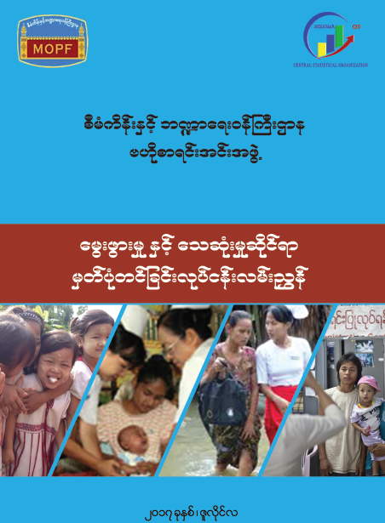
Based on
International Standard and
Practices
“The Manual
on
Birth and Death Registration”
has been launched
in October 2017

Slide 14
In the absence of CRVS law,
this manual will be a good guiding document
as its covers all procedures and principles
to proceed with vital registration process

Slide 15

Planning and Implementation;
Procedures;
Archiving;
Statistical Reporting
Using this manual, we will be training Basic Health Staff from States and Regions during Nov-Dec, aiming at improving the registration processes and effective rollout.

Slide 16

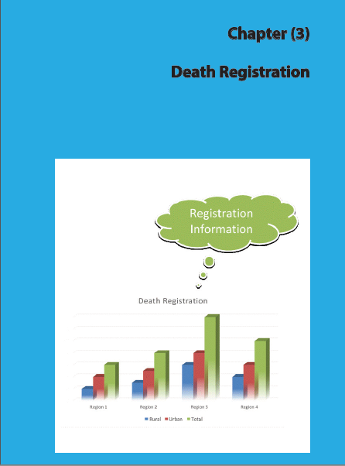
UBR principles to register all under 10 children born within Myanmar regardless of geographic.
For the effective implementation detail directive will be
prepared
and
shared
at the
BHS Training.
Vital Registration Officer must register all deaths that occur in their responsible areas and must be reported within three days.

Slide 17
Next steps for 2018 and beyond:
Technical work:
With IAWG group to provide with progress and planning;
Policy work:
With Coordination Committee on Birth and Death Registration for advocacy work and seeking guidance;

Slide 18

Thank you for your attention

