Slide 1
A strategy for improving CRVS in Lao PDR
Country Team Representative
Hanoi, 17 Nov 2017

Slide 2
Rationale for improvement of CRVS systems (1)
To achieve the Vision 2030 and the Strategic Socio-economic Development Plan 2016-2025 of the Government,
By 2030 citizen’s rights will be guaranteed by the state governance by the Law.
By 2025 Lao citizen will complete at least secondary school. Lao population will have access to universal health coverage and average life expectancy will be higher than 73 years old, the large majority of the population is covered by social protection schemes and the labor force is developed in quantity and quality.

Slide 3
Rationale for improvement of CRVS systems (2)
It is also needed to monitor its achievements of the SDGs. The importance of CRVS and identity management systems is recognized in the following SDG targets or indicators:
Target 16.9: By 2030, provide legal identity for all including birth registration.
Target 17.18: By 2020, enhance capacity-building support to developing countries including for LDCs [least developed countries] and SIDs [Small Island Developing States], to increase significantly the availability of high quality, timely and reliable data disaggregated by income gender, age, race, ethnicity, migration status, disability, geographic location and other characteristics relevant in national context. (CRVS is the most reliable source of disaggregated data.)

Slide 4
Rationale for improvement of CRVS systems (3)
Target 17.19.2b: Proportion of countries that have achieved 100 percent birth registration and 80 per cent death registration.
To achieve the government’s committed that by 2024 it will do it utmost to ensure that all citizen and the newborns are registered and received official birth certification at least 70%.

Slide 5
The main obstacles for achieving complete coverage of vital events and for improving accuracy for registered information
Organization: The roles and responsibilities was not clear enough and some activities still overlap.
Functioning: The coordination among involved line ministries remains difficulty. The operational procedures involved several steps and were not uniform. There are no standard operating procedures (SOPs) such as: forms, service processes. The reporting, monitoring and evaluation remain are irregular.
Service Delivery: processes are multistep, complicated, expensive, and time consuming.
Community awareness: A large part of the population does not know about the benefits of civil registration and certification.
Budgets provided were limited and could not answer yet the needs for the implementation of the activity

Slide 6
The main obstacles for compiling vital statistics based on civil registration data as the main source
Staffing is insufficient in number and quality. Not all responsible staffs have been properly trained on CRVS.
Civil registration data is incomplete, fragmented, not integrated and centralized, and thus could not be summarized and reported nationally.
MOHA, the lead institution for civil registration, civil management, still does not have an electronic management information system.

Slide 7
Effort carried out or underway for assessing the quality of CRVS system
The CRVS strategy was approved by the Government and endorsed in 2017. it has three main goals: 1) civil registration of births, deaths, and other vital events is universal; 2) all individuals are provided with legal documentation of civil registration of birth, death, and other vital events, as necessary, to claim identity, civil status, and ensuing rights; and 3) accurate, complete, and timely vital statistics (including causes of deaths), based on registration records, are produced and disseminated.
Law on family registration is amending.
Registration forms is revising,
Coordination among all involved vertically and horizontally is essential for accurate, complete, and timely vital statistics- a multi-sector coordinating committee is needed;

Slide 8
Measures taken to improve quality and interoperability of CRVS (1)
MOHA is responsible for developing the CMIS which will allow front-ending all the citizen services to incorporate the vital events into ICT-enabled processes and data, and address the interoperability among the administrative registers of several sectors. For instance, the CMIS will be interoperable with the database for the family book and national ID card managed by the MPS or with the (DHIS2) database managed by MOH. Other potential administrative registers such as civil service, social safety nets, pensions, social security, passport, transportation/driver’s license, taxes, finance, education, voter rolls, and immigration.
Generate vital statistics from the civil registration database - Once the centralized database is operational, monthly, quarterly, annual vital statistics will be produced, disseminated and used.

Slide 9
Measures taken to improve quality and interoperability of CRVS (2)
Human resource and capacity building-Having adequate numbers of staff to carry out CRVS tasks is important. Regularly training is needed for both central and local staff concerns line ministries (registrars, statisticians, doctor, midwife etc) on ICT, ICD 10 and CRVS.

Slide 10
3 Pilot provinces implementation
CMIS is piloting in 3 provinces and 31 districts;
Centralize database: All POHAs and DOHAs offices in the pilot provinces will send data real-time online data directly to MOHA.
Health facilities that have internet access will do electronic birth notification.
Unique identification number (UIN) will be assigned at birth on the birth certificate and the same number will be used at age 15 years and above for the issuance of national ID card.
Civil registration of Vital events will be dispatched to Lao Statistic Bureau for Vital Statistics and to MPS for households records and ID management.

Slide 11
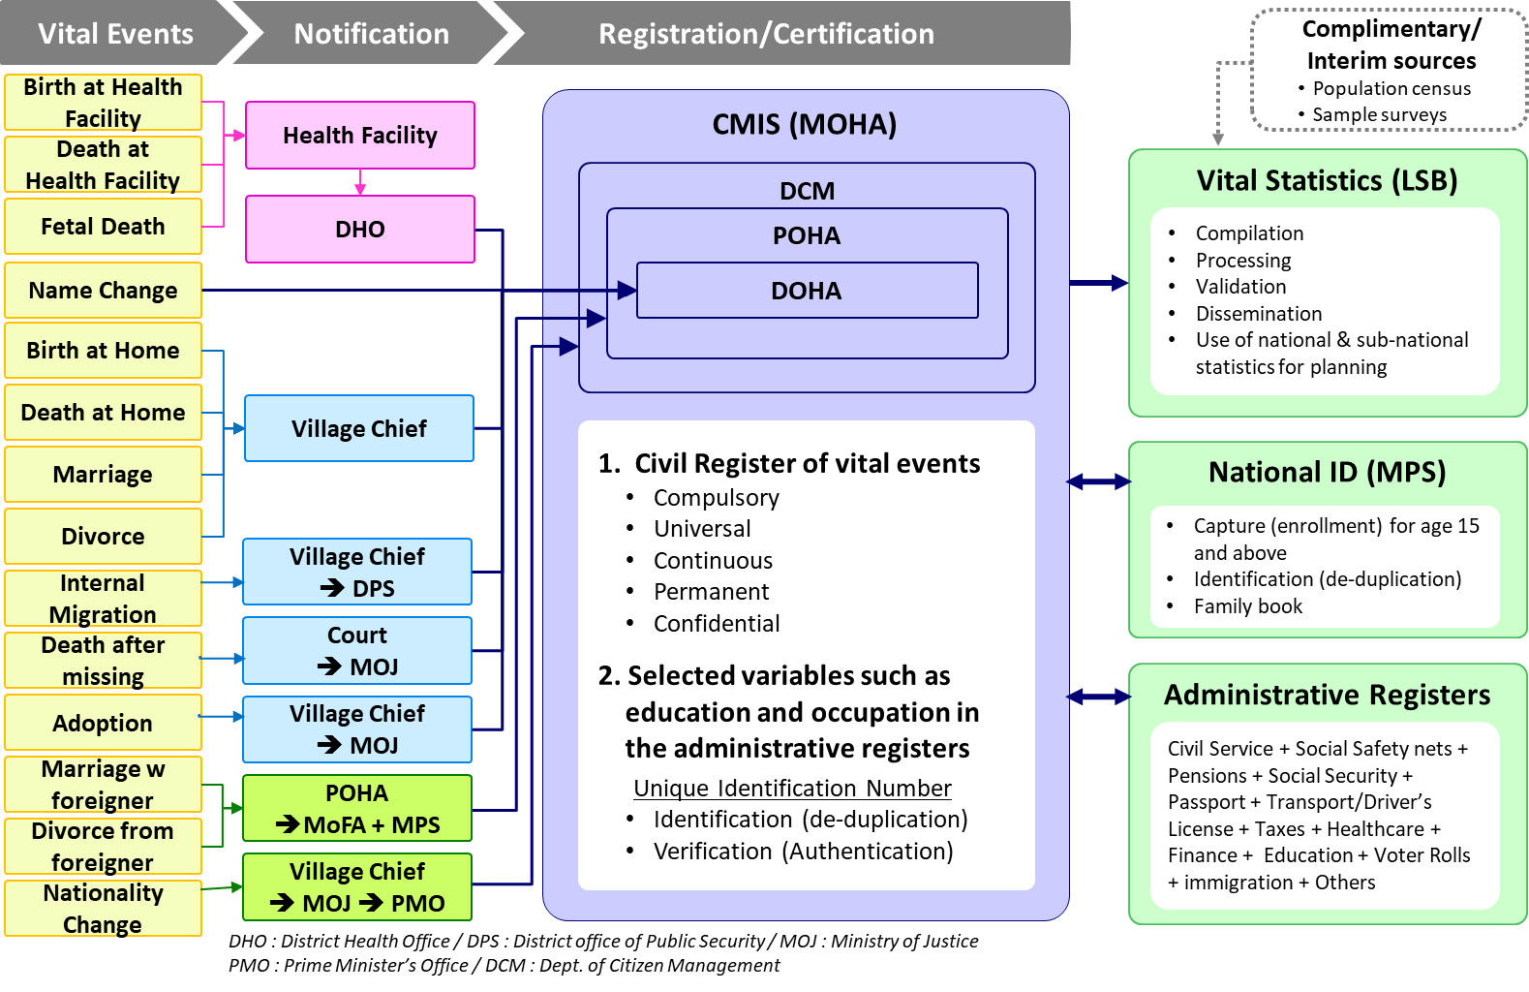
CMIS Stakeholder's View

Slide 12
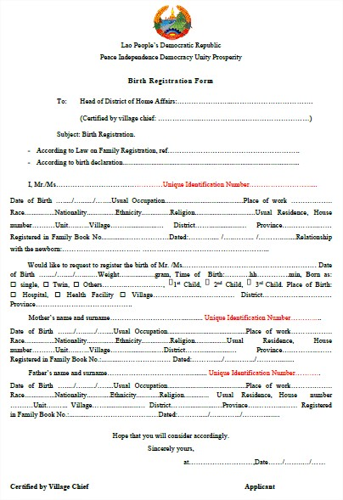

Slide 13
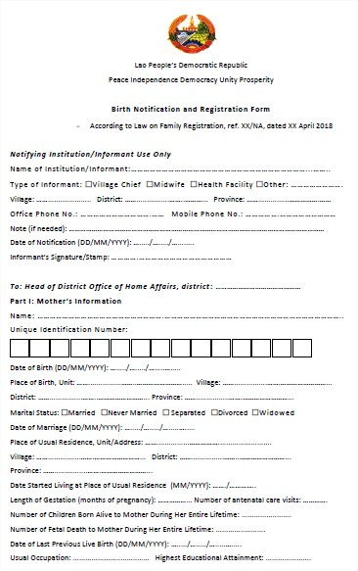

Slide 14
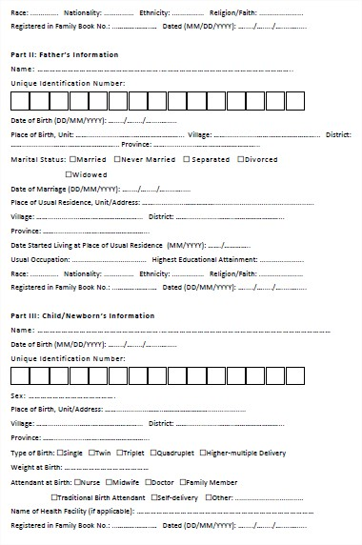

Slide 15
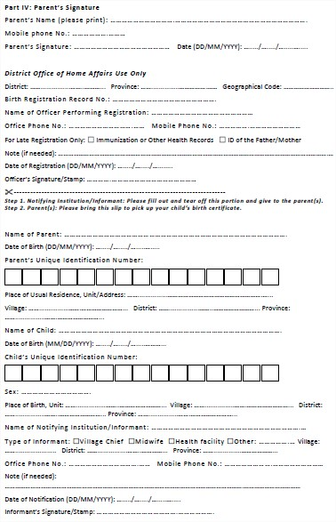

Slide 16
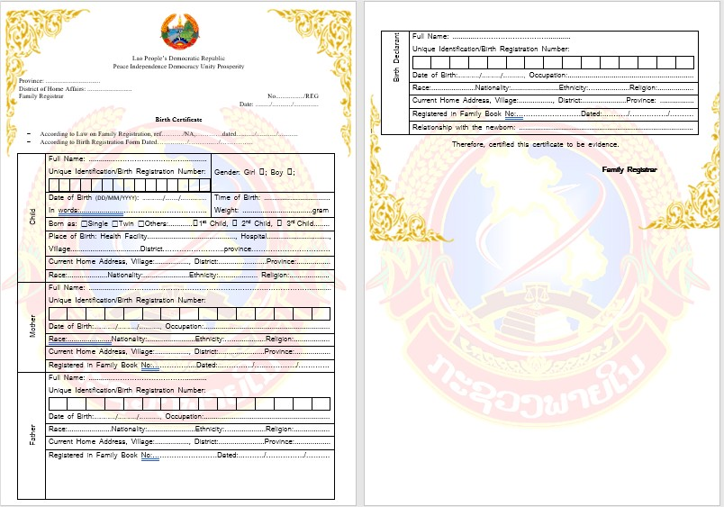

Slide 17
Thank you!
This is our Future, our CRVS

