Slide 1
Session: 12
Integrating civil registration, vital statistics, population registers and identity management,
15 November 2017
Workshop on the Operation of Civil Registration,
Vital Statistics and Identity Management Systems for East Asian Countries
@ United Nation House, Hanoi, Vietnam
Benjakarn Leelakittisin, M. Pharm
Pharmacist and Health IT Professional
Thai Health Information Standards Development Center (THIS)
Ministry of Public Health, Thailand
Notes:
Hello everyone,
I’m from Thailand
My name is Benjakarn Leelakittisin, Master of Pharmacy
I work at Thai Health Information Standards Development Center as a Pharmacist , Health IT Professional and also data management analyst
In this session, I will talk about the context of the CRVS system in Thailand

Slide 2


outline
History of vital statistics system in Thailand
Previous CRVS Study
Status Update: Thailand
CRVS workshop @ Hanoi 13-17 nov 2017
Notes:
My presentation will go through this outline list
Start with History of vital statistics system in Thailand
describe Previous CRVS Study of THIS in Thailand
And Status Update

Slide 3

History of vital statistics system in Thailand

Slide 4
Year | Related history
1920 | compilation of vital statistics
1942 | Vital Statistics Division was established in the MOPH
1993 | MOPH was restructured vital statistics function was moved to the Health Information Centre
Before 1996 | MOPH officers compiled birth and death statistics from paper forms provided by MOI’s local and central registration offices discrepancies in data from MOPH’s and MOI’s MOPH was unable to produce timely national vital statistics (2-3 years delay)
1996 | MOPH signed an agreement with MOI, regarding utilization of vital registration data from the central registration database of the administration (expected to reduce redundancy)
Since 2002 | Health service records for reimbursement from public health insurance have been used to validate cause of death data from CR system.

Slide 5
MOPH Vital statistics Before 1996
Ministry of Interior
Central Registry
Ministry of Public Health
Compile, code, validate and process statistics
Ministry of Interior
Central Registry
Ministry of Public Health
Compile, code, validate and process statistics
Printed Annual Vital statistics report
Copy birth/death list for validation
Printed Annual Vital statistics report
Aggregated report by Province
Send copy of death certificates
Provincial Health offices
Provincial Health offices
Hospitals
Hospitals
MOI
Local Register
Copy Birth/
Death list

Slide 6
Thai Vital Statistics after 1996
BORA
Ministry of Interior
Central Registry
Ministry of Public Health
Compile, code, validate and process statistics
Electronic files
Printed/ Web Vital statistics report
Report statistics back to provinces
Data Sync.
Web entry Birth certificate
(Start 2010)
Web entry death certificates (start 2006)
National Health Security
Office (NHSO)
Provincial Health offices
Hospitals

Slide 7
Previous CRVS Study

Slide 8
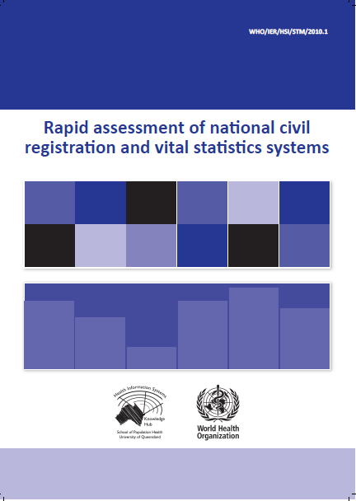
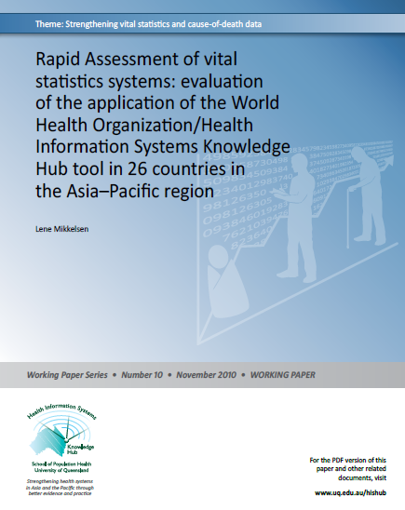
Civil Registration & Vital Statistics evaluation

Slide 9
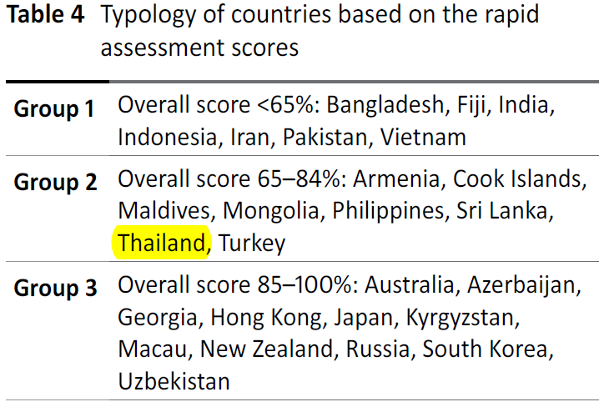
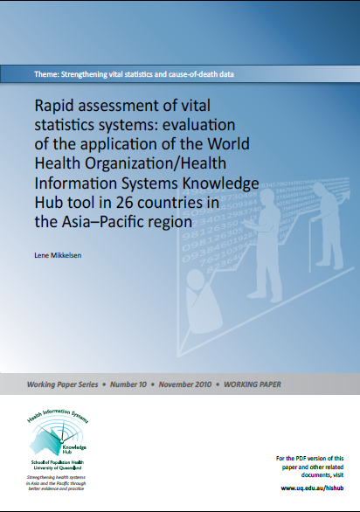
From: Mekklesen L., Rapid assessment of vital statistics systems: evaluation of the application of the World Health Organization/Health Information Systems Knowledge Hub tool in 26 countries in the Asia–Pacific region, working paper 2010 University of Queensland

Slide 10

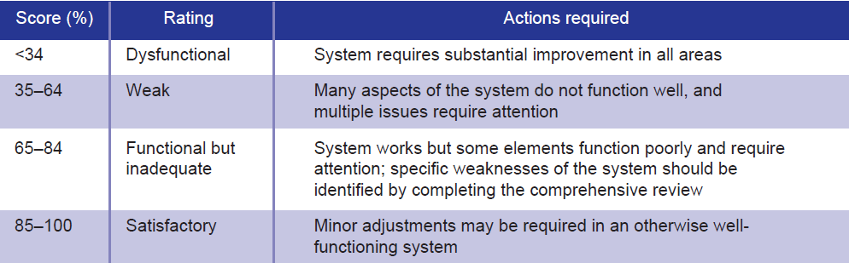
Rapid assessment result
Total score 84

Slide 11

Death counts and Cause of Death (COD)
Data : Total death ~400,000 / year
Death data processed
  Code cause of death with ICD 10
  Compile and Analyzed
  Annual reports in print and web format
  Provide provinces population, birth, death information every month
Results: defined and unknown cause of mortality (R0-R99) has been decrease from 45% to 37%

Slide 12
Problems of Causes of death data 1
High % of lll-defined causes of death
  Non-hospital death
  In-hospital death

Slide 13
Problems of Causes of death data 2
Misclassification of causes of death
  Non-hospital death
  In-hospital death

Slide 14
Improving COD statistics
1.Improving COD data for in-hospital death
2.Improving COD data for non-hospital death
3.Validation for COD statistics through Verbal Autopsy

Slide 15
1. Improving in-hospital COD data
Training for medical doctors to define actual COD in medical death certificate
  Reduce mode of death, un-specified causes, injury code
  Reduce misclassification, wrong selection
Medical records and coding audit for better quality of diagnosis of diseases and causes of death

Slide 16
2. Improving non-hospital COD
Using electronic in-patient records for defining outside hospital COD
Match death outside hospital with recent hospitalization using citizen identifier number or 13 digits number
Using local health personnel to provide COD (accompanied with VA tool and medical history)

Slide 17
3.Validation for COD statistics through Verbal Autopsy
use Verbal autopsy questionnaire to improve Cause of Death information
piloting project: using a customized VA tool by rural health personal to interview the deceased’s relative before registering to civil registration system
Preliminary results: Ill-defined COD (ICD 10 code R00-R99) decrease from 41%(2007) to 27%(2008) and 25%(2009)

Slide 18
Status Update: Thailand

Slide 19

Status Update
Main national stakeholders (Who are the national stakeholders engaged in CRVS activities?)
  The national authority for civil registration, Bureau of registration administration, Ministry of Interior: to register, record vital statistic, operates and maintains the database for entire population of country
  Ministry of Public health: Data on cause of death and mortality coding including compilation, statistical processing, and publication of vital statistics
  National Statistical Office: collect data by survey , compare the data quality and accuracy then report the statistic.

Slide 20
Implementation steps
Status of National improvement plan (Has a national CRVS improvement plan been developed? If not, what is the status of development?)
  Training on cause of death for health care professionals and registrars or related officers to increase the reliability of cause of death data in 77 provinces.
  Change system of the person who give cause of death outside hospital from head village to local or district registrars

Slide 21
Activities
Ongoing/planned activities (Outline planned and ongoing activities related to one of the action areas of the Regional Action Framework)
  ACTION AREA: Operational Procedures covering 77 provinces in Thailand
  ACTIVITIES:
    local or district registrars identify the cause of death in outside hospital
    Evaluate the data accuracy on cause of death after adopting the policy

Slide 22
Additional Reading
RAPID ASSESSMENT OF NATIONAL CIVIL REGISTRATION AND VITAL STATISTICS SYSTEM : A case study of Thailand
http://www.this.or.th/view.php?id=81
REVIEW OF NATIONAL CIVIL REGISTRATION AND VITAL STATISTICS SYSTEMS: A case study of Thailand
http://www.this.or.th/view.php?id=77
Notes:
If you want more information about our research
You can visit these URL that I’m showing in the slide
RAPID ASSESSMENT OF NATIONAL CIVIL REGISTRATION AND VITAL STATISTICS SYSTEM : A case study of Thailand
http://www.this.or.th/view.php?id=81
REVIEW OF NATIONAL CIVIL REGISTRATION AND VITAL STATISTICS SYSTEMS: A case study of Thailand
http://www.this.or.th/view.php?id=77

Slide 23
Contact Information
this@this.or.th
www.this.or.th
CRVS workshop @ Hanoi 13-17 nov 2017
Notes:
If you have question you can contact our office via this email or visit our organization’s website

Slide 24
Special Thanks
CRVS workshop @ Hanoi 13-17 nov 2017
Notes:
I’m ending the presentation with
Special thanks to my boss Dr.Boonchai and also all related parties and person
-------------------
Boonchai Kijsanayotin MD., PhD.(Health Informatics)
AeHIN Chair
Health Information Standards Development Center (THIS)
Ministry of Public Health, Thailand
----------------------------------------------
for his support and slide
Dr. Boonchai Kijsanayotin

Slide 25
Thank you everyone for your attention
CRVS workshop @ Hanoi 13-17 nov 2017
Notes:
And also Thank you very much for everyone’s attention
Thank you

Slide 26
Three models describing the flow of information and accompanying in CRVS

Slide 27
3 models are
civil registration and vital statistics as separate components without population registers
civil registration and vital statistics with the use of population register
the holistic functioning of civil registration, vital statistics and identity management.

