Slide 1


Institutional arrangements and integration of civil registration, vital statistics, population registers and identity management
General Department of Identification (GDI)
Ministry of Interior
Kingdom of Cambodia
Notes:
Good afternoon Ladies and Gentlemen !
It is my great pleasure to be here with all of you today in a beautiful city Nay Pyi Taw.
I also thank to the Center of Humanitarian Dialogue that inviting me and my colleague to joint this important workshop.
I also thank to Ministry of Labor, Immigration and Population that allowing Cambodia to share with you the our lesson learnt so far on the issues of ID Card initiative.

Slide 2
Background
  Civil Registration & Nationality works were under the responsibility of General Department of Local Administration
  Completely paper-based system
  Residential system was under the responsibility of National Police
  Khmer ID Card & Passport was under the responsibility of National Police
  No linkage with other identification system
  Function of each area was under the separate Sub-Decree/Regulation (not meet international standard)
  Not able to generate vital statistic
  CRVS was not top priority of the Government.

Slide 3
New development of CRVS & ID Management System
  General Department of Identification established in 2014 (GDI)
  National Strategic Plan of Identification approved by government in June 2016
  Final draft of NSPI Implementation Plan (2017)
  National Steering Committee on CRVS & ID Management (NSCI) established in May 2017, chair by DPM & Minister of Interior
  National Technical Program Implementation Team (TPIT), chaired by GDI
  Government agreed on PPP approach to invest in ICT infrastructure and system.

Slide 4
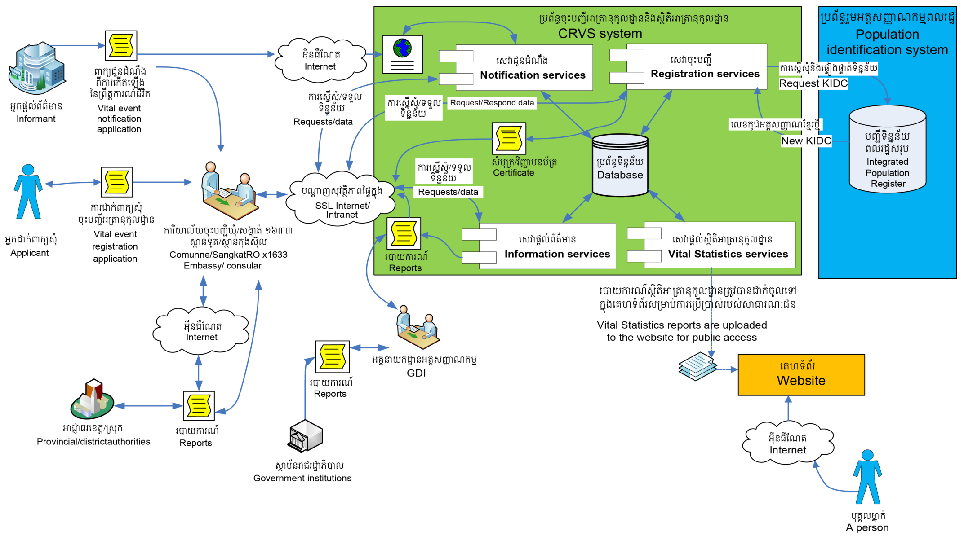
Conceptual designe on integrated CRVS & ID Management Sysetm
Notes:
The conceptual design of CRVS system is composed of at least 4 major services:
1. Notification Service : that handle notifications from the authority that witnessed the appearance of the vital event. This notification will enter and store in CRVS system until applicants arrive with the original copy and request registration of vital event.
2. Registration Services : these service handle the collection of the application dossier to register the vital event. They also handle data entry and the uploading the scanned annexes as well as data verification process, registration approval process and issuance registration certificate. Via the internet all registration offices connect to the CRVS and perform registration. A KidC is assigned upon the approval of an application to register birth event.
3. Information Services : these services handle request for information by public users via CRVS information services. Request are accepted manually (on paper) or online. The CRVS will have the possibility to notify appropriate institutions about vital events upon a signed agreement of cooperation. Notification could be performed through defined notification channels.
4. Vital Statistic Services: these services handle the generation of information according to the vital statistic tabulation plan, which is later published online for public access.
The CRVS system should be integrated with the Population Identification System on a system-to-system basic, according to the specification developed and provided together with the Population Identification System.

Slide 5
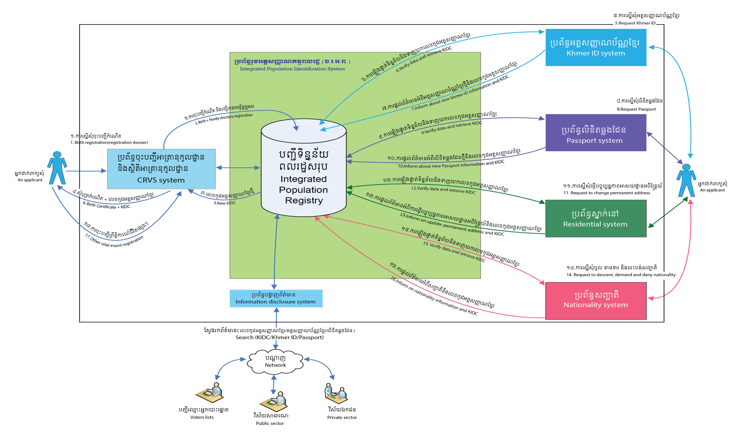
Conceptual designe on integrated CRVS & ID Management Sysetm
Notes:
This is the conceptual design for IPIS:
This design will guide us to have reliable nationwide information on the population as well as unique identification for every person of Cambodia. Data in Population Registry is to be constantly updated (preferably in real time) from other systems.
Existing and emerging computerized systems related to identification need to be integrated to the Population Identification System (IPIS) on a system-to-system basis in order to be able to search for actual and correct information on individuals such as:
- Civil Registration and Vital Statistics System
- Khmer ID Card Management System
- Passport Management System
- Residential Management System
- Nationality System
The conceptual design of the IPIS integrates all systems involved in the continuous recording of information pertaining to each member of the resident population of a country, making it possible to determine up-to-date information about the size and characteristics of the population at selected points in time. The CRVS acts as the initial registration point, where a new record for an individual is created in the Population Identification System and a new Khmer Identification Code (KIDC) is generated and assigned to it.
IPIS will enable different institutions to share the same information about the individuals, and to search and contribute to the updating information on individuals. The IPIS should ensure secure information disclosure to the authorized recipients of information and therefore should integrate with the information distribution system.

Slide 6
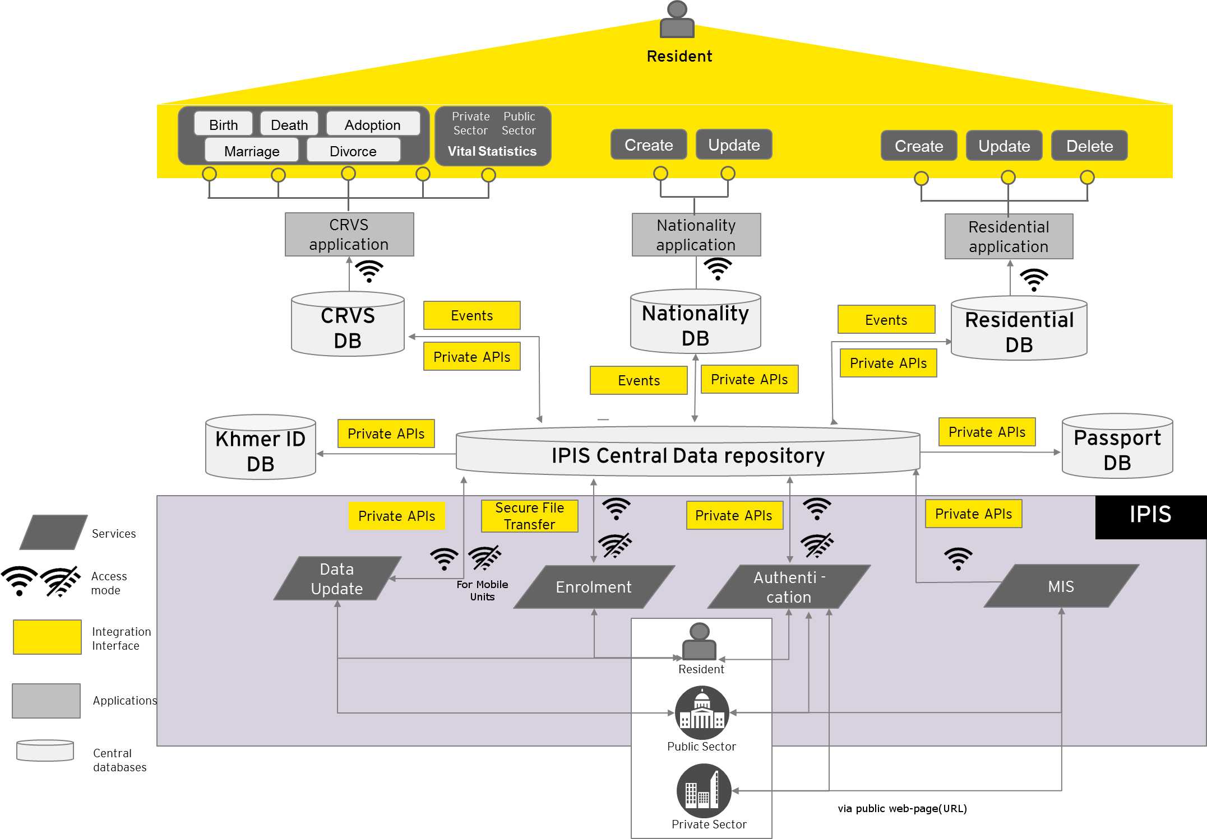
Conceptual designe on integrated CRVS & ID Management Sysetm

Slide 7
Charlenges
Lack of comprehensive law on CRVS and ID management system
ICT infrastructures need big investment
Limit resource allocation for CRVS and capacity of local registrar
Lack of systematic notification of vital events
Lack of awareness on importance of birth, marriage and death registration and sharing/use CRVS data.

Slide 8
Thank You !
Notes:
Ladies and Gentlmen
I finish my presentation here and welcome for commends, suggestions and question.
Thank you.

