Slide 1
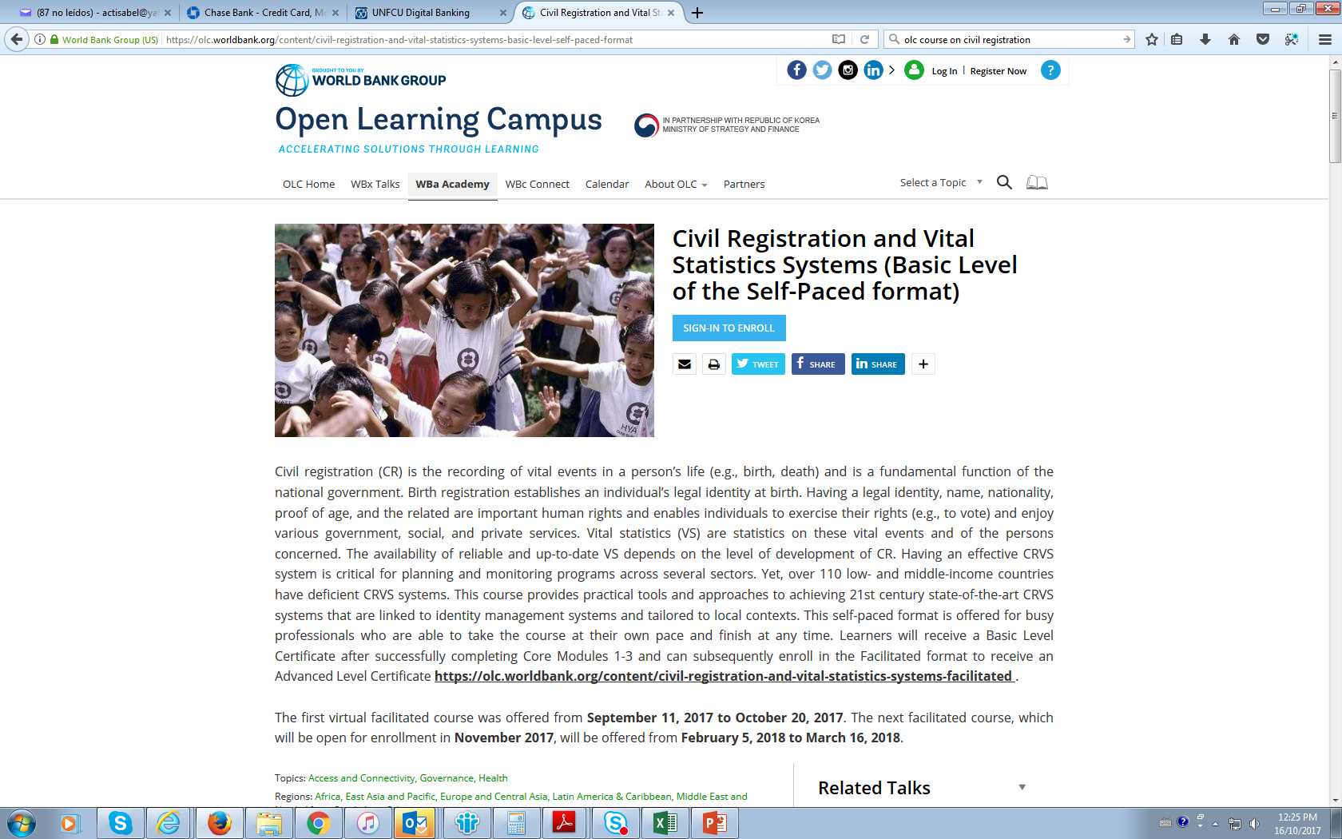
E-learning course
https://olc.worldbank.org/content/civil-registration-and-vital-statistics-systems-basic-level-self-paced-format

