Slide 1
Overview of the outcomes of the Ministerial Conference and the role of the National Focal Points
Workshop for National CRVS focal points
Bangkok, Thailand
9-10 December 2015

Slide 2





Ministerial Conference on CRVS 2014: Outcomes
Declaration of the Asia-Pacific CRVS Decade 2015 – 2024
Ministerial Declaration to ‘Get Every One in the Picture’ in Asia and the Pacific
Regional Action Framework comprising:
  3 Goals
  15 targets set individually by countries
  7 Action Areas
Notes:
Two outcome documents from the Ministerial Conference:
A Ministerial Declaration to ‘Get Every One In The Picture’
A Regional Action Framework for the Decade, which contains 3 goals that you can see on the bottom right
Universal civil registration (blue icon)
All individuals are provided with legal documents to claim identity and ensuing rights (red icon)
Accurate, complete and timely vital statistics (green icon)
The Regional Action Framework have 7 areas of action, and under each of the goals a framework of targets that each country would set individually, for example by 2024, 99% of births shall be registered and 80% of deaths shall be registered.

Slide 3


Commitment by 2024
Universal civil registration of births, deaths and other vital events;
All individuals are provided with legal documentation of civil registration of births, deaths and other vital events, as necessary, to claim identity, civil status and ensuing rights
Accurate, complete and timely vital statistics (including causes of death) are produced based on registration records and are disseminated
Notes:
The goals and targets of the Regional Action Framework offer measureable outcomes that reflect progress towards the achievement of the shared vision that “all people in Asia and the Pacific will benefit from universal and responsive CRVS systems that facilitate the realization of their rights and support good governance, health and development” during the course of the decade 2015-2024.
Associated with those 3 goals are 15 targets. Member and associate members will set their own national target value for each target based on their ambition and capacity.

Slide 4
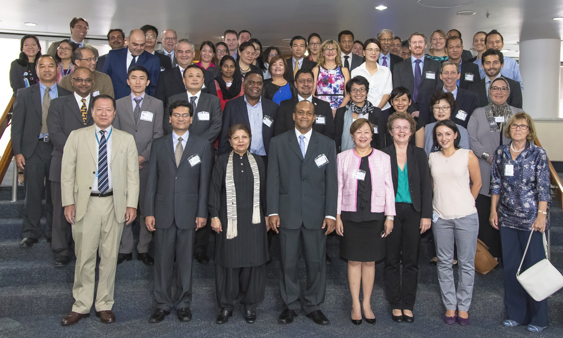
Regional support to national implementation
Regional Steering Group:
  Provide regional oversight and guidance for implementation of the Regional Action Framework
  Act as custodian for CRVS decade 2015 – 2024
  Facilitate synergies between the regional initiative, sub regional and global initiatives
  Sub groups on: Communication, Research, Monitoring and reporting
At national level:
  Implementation will be overseen by the national CRVS coordination mechanism and communicated via the National CRVS Focal Point
Notes:
22 country members and 8 development partners. High level members from 4 sectors: planning, health, statistics and civil registration.
Member countries include:
East and North-East Asia: Mongolia;
South East Asia: Cambodia, Indonesia, Malaysia, Philippines, Thailand
South and South-West-Asia: Bangladesh, Bhutan, India, Iran (Islamic Republic of), Pakistan,
North and Central Asia: Armenia, Kazakhstan, Uzbekistan
Pacific: Cook Islands, Fiji, Vanuatu
Government Development Partners: Australia, New Zealand, Republic of Korea, Turkey, USA
Institutional Members: UNICEF, UNHCR, WHO, World Bank Group, Brisbane Accord Group, Data2X, Plan International, World Vision International
Nomination process: Countries were asked to submit nominations. These were considered by the Committee on Statistics who made a suggestion on the composition of the group to the 71st Commission session (May 2015).
RSG met for the first time in July 2015
Two vacancies were filled by the RSG
RSG is until 2019
Meetings are generally open to observers
Bureau consist of
Chair: H.E. Mr. Jone Usamate, Minister of Health, Fiji;
Vice Chair: Mr. Abul Kalam Azad, Additional Director-General, Directorate General of Health Services, Ministry of Health and Family Welfare, Bangladesh; (represented at the meeting by Mr. Anir Chowdhury, Policy Advisor, Access to Information Programme, Prime Minister’s Office, Bangladesh)
Vice Chair: Ms. Lisa Grace Bersales, National Statistician and Civil Registrar-General, Philippines Statistics Authority, Philippines.
The subgroups welcome members from member countries independent on RSG status. Interested individuals can contact Tanja

Slide 5
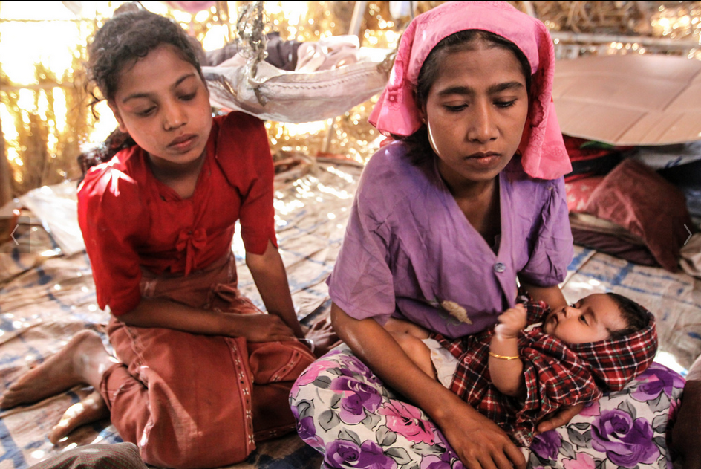
Key Principles
Countries take the lead
A stepwise approach
Flexibility and responsiveness
Building on local expertise
Consistency with international legal principles
Coordination and alignment, including with sub regional initiatives

Slide 6
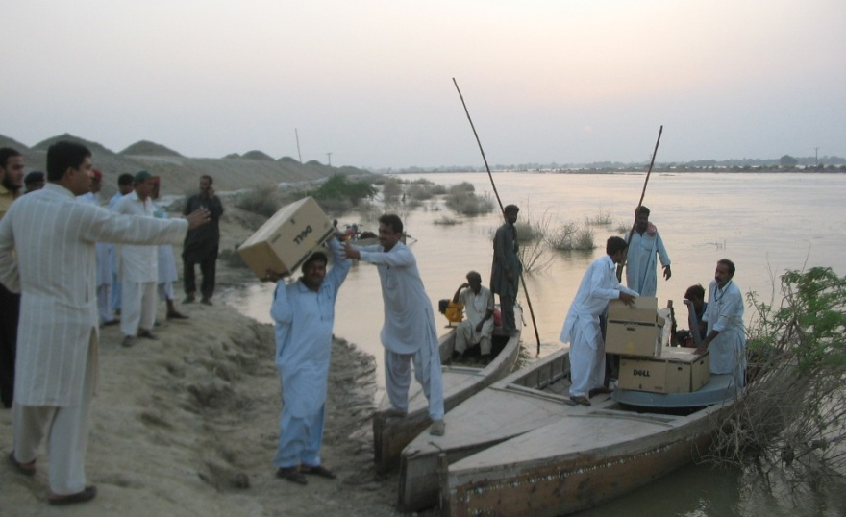
Action Areas
Political commitment
Public engagement and participation
Coordination
Policies, legislation and implementation of regulations
Infrastructure and resources
Operational procedures, practices and innovations
Data quality, production, dissemination and use of vital statistics

Slide 7
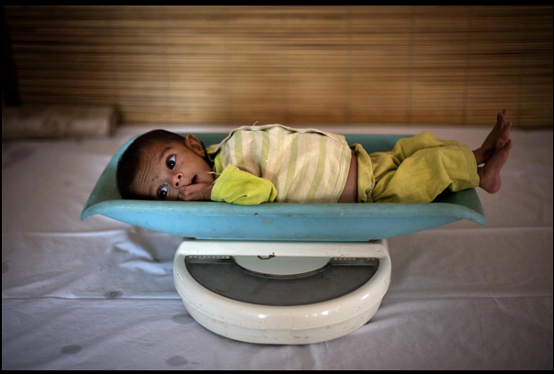
Implementation steps
National CRVS coordination mechanism
Conduct a comprehensive assessment
Set the national target value for each target Assess inequalities related to CRVS experienced by subgroups of the population, and, where appropriate, set national targets to address those inequalities
Comprehensive multi-sectoral national CRVS strategy
Assign a national focal point
Report relevant information to the ESCAP secretariat by December 2015
Notes:
All countries are supposed to follow these implementation steps. Many countries have already taken several of these steps, including comprehensive assessments and the establishments of national coordination mechanisms.

Slide 8

National Focal Points
One of the implementation steps of the Regional Action Framework
  Crucial role in the implementation of the Regional Action Framework
  well-functioning, engaged and knowledgeable network of NFPs will be instrumental in the success of the CRVS Decade
Notes:
Focal points identified in 34 countries. The focal points are being regularly informed of CRVS initiatives through a CRVS news updated distributed 1-2 a month. In addition, the focal points was sent direct information regarding reporting this week.

Slide 9
National Focal Points
Ensure communication between CRVS stakeholders in the country as well as ESCAP and development partners
Provide ESCAP with continuous updates including responding to requests for reporting
Be the link between the national and regional on behalf of all CRVS stakeholders in the country

Slide 10

Want to know more?
Check out the brochure with the Ministerial Declaration and Regional Action Framework www.unescap.org/resources/asian-and-pacific-civil-registration-and-vital-statistics-decade-2015-2024
See our new website www.getinthepicture.org

Slide 11
Thank you!
For more information, please visit: www.getinthepicture.org

