Slide 1
Discussion of CRVS strategies
Regional workshop on outcomes and lessons learnt from technical
assistance projects in support of improving CRVS systems
Bangkok, 18 – 19 April 2016

Slide 2




Objectives for the session
See current efforts from a strategical perspective
Insight to country experiences
Agenda
Context
Strategic thinking
Strategy and CRVS
Strategy process model
Practical examples
Wrap up

Slide 3
Context

Slide 4

Implementation steps
National CRVS coordination mechanism
Conduct a comprehensive assessment
Set the national target value for each target
Develop and implement a plan for monitoring and reporting on the targets
Assess inequalities related to CRVS experienced by subgroups of the population, and, where appropriate, set national targets to address those inequalities
Comprehensive multi-sectoral national CRVS strategy
Assign a national focal point
Report relevant information to the ESCAP secretariat by December 2015

Slide 5
Why a strategy?

Slide 6
What is a strategy?
“Method or plan chosen to bring about a desired future, such as achievement of a goal or solution to a problem”
→ In other words, how to reach the goals and national targets of the CRVS decade.

Slide 7
Thinking strategical
How do we go from ad hoc activities to systems?
How do we avoid organizational setups which has practices were parts of the CRVS are produced in isolation ?
How do we achieve a set up which is systemic, holistic, comprehensive and coordinated?
Do you have examples of ad hoc activities or silos-thinking?
  Do you have examples of systemic, holistic and well coordinated approaches?

Slide 8
Strategy process model and CRVS

Slide 9
Anatomy of a strategy – asking the right questions
Strategy | CRVS decade
Phase 1 – strategy analysis
What services are we producing, and why?
Where are we going?
Where are we now?
What are our key issues?
What is CRVS
3 goals, 15 targets and 7 action areas
Comprehensive assessment
Regional baseline analysis
Phase 2 – strategy formulation
How do we get there?
Translating the Regional Action Framework into your country context
Phase 3 – strategy implementation
Can we do it?
Do we have the resources and capability?
Establishing an effective and sustainable national CRVS coordination mechanism comprising all relevant stakeholders
Ensuring resource availability (national-donor support?)
Phase 4 – strategy review
How have we performed?
What is the progress?
Reporting and regional reviews
Regional baseline analysis
Midterm report
Final regional review

Slide 10
Review of the phases

Slide 11
Phase 1 - Strategy analysis, part a
Phase 1 | Objective | High-level activities
Strategy analysis | To clearly identify the services we are interested in and what issues we have to address in order to get the service going; or, if the service already exists, the issues we need to address to take corrective action. | (a) Setting the direction. (b) Setting strategic goals. (c) Strategic analysis of the CRVS system.
a) Setting the direction | To re-affirm the organizational purpose and conduct. | Step 1: Reviewing or developing a mission statement. Step 2: Reviewing or developing a vision statement. Step 3: Reviewing or defining core values.

Slide 12
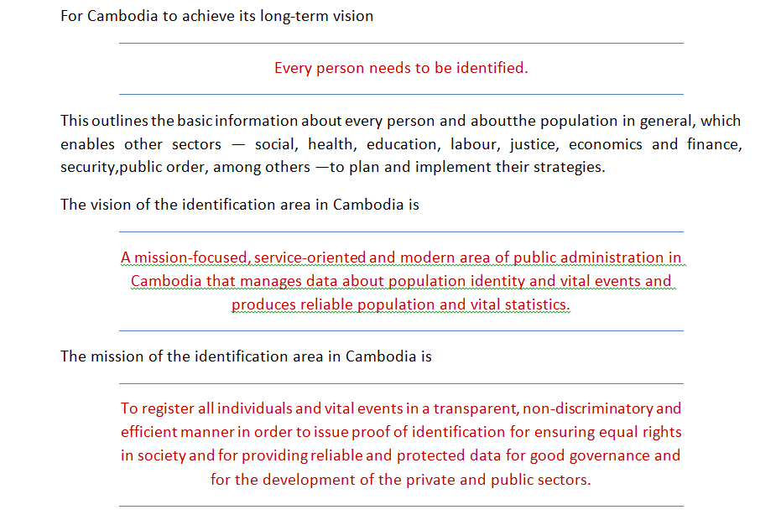
Example of developing a mission

Slide 13
Phase 1 - Strategy analysis, part b
Phase 1 | Objective | High-level activities
b) Setting strategic outcomes and goals | To clearly define the highest level of goals and outcomes that will drive the strategy. | Step 1: Define strategic outcomes. Step 2: Develop long-term strategic goals

Slide 14
Phase 1 - Strategy analysis, part c
Phase 1 | Objective | High-level activities
c) Strategic analysis of the current environment | To identify, through structured analysis, the events, forces, processes and experiences that impact and modify the strategy. | Stakeholder analysis Identification of weaknesses and problems Assess past and present performances Consolidate information and identify problems. Arrange information from the assessment into a SWOT1 matrix. Prioritize information. Define problem statement and strategic shift.

Slide 15
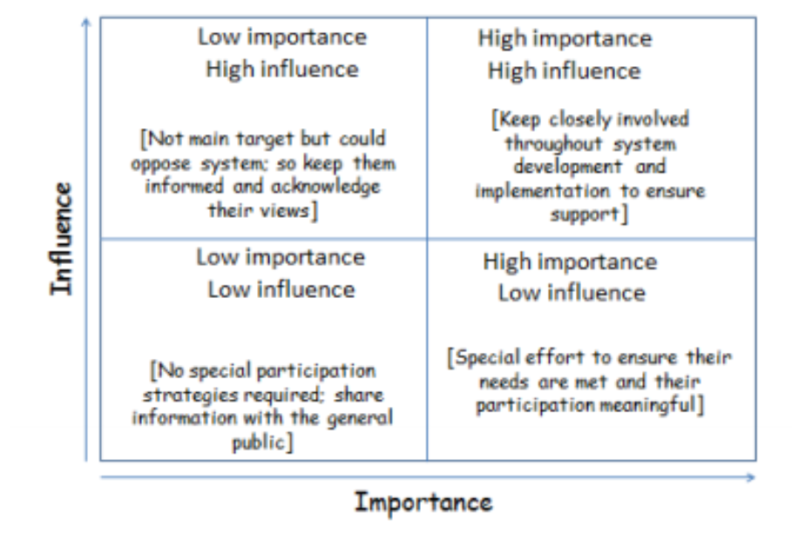
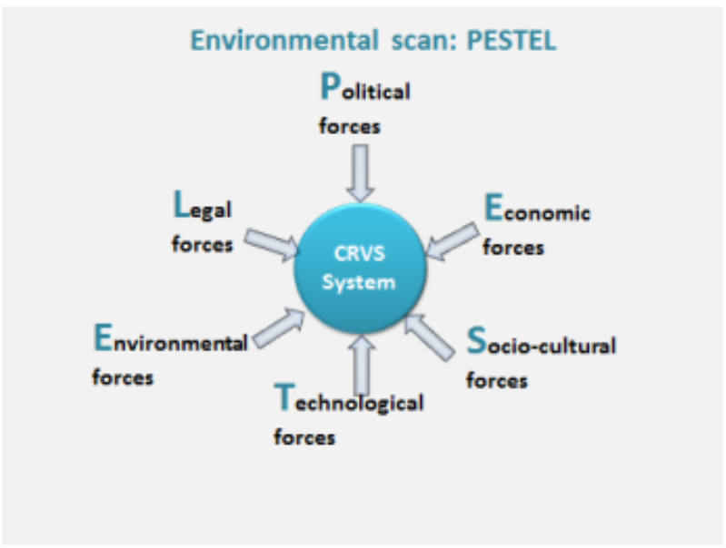
Stakeholder analysis

Slide 16
A practical example – SWOT
Internal Weaknesses | Internal Strengths | (Resulting) Strategy
No linkages with Statistics Office | National and civil registration organically linked | Formalize linkages through legislation or policy
Coding causes of death | Qualified personnel ICT infrastructure in place | Automate the coding of causes of death Train civil registration staff in coding of death
Some civil registration offices are far away from people or citizens | Mobile registration in place | Expand mobile infrastructure to remote areas
Separate forms are used by Ministry of Health and civil registration for causes of death | Strong linkages between civil registration and Ministry of Health | Formalize linkages through legislation or policy

Slide 17
A practical example – SWOT
 | Internal strengths | Internal weaknesses
External opportunities | Match: strengths and opportunity strategies Formulate a strategy to capitalize on these areas of the CRVS system | Match: weaknesses and opportunity strategies Formulate a strategy to improve these areas of the CRVS system
External threats | Match: strengths and threats strategies Formulate a strategy to monitor these areas of the CRVS system | Match: weaknesses and threats strategies Formulate a strategy to eliminate these activities
Provides a platform for decisions

Slide 18
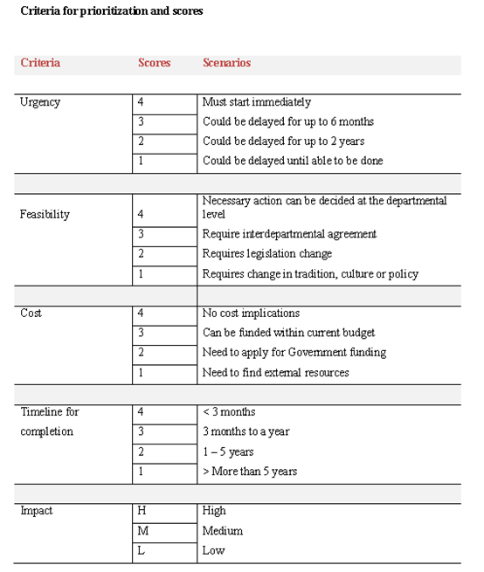
Making a strategical decision demands overview and prioritizing

Slide 19
Phase 2 – Strategy formulation
Phase 2 | Objectives | High-level activities
STRATEGY FORMULATION | To define where and how the organization will respond. | Step 1: Develop or review value chain of the TO-BE process). Step 2: Develop strategic objectives. Step 3: Develop subobjectives. Step 4: Compile a strategy map. Step 5: Define the strategic intent. Step 6: Identify critical success factors. Step 7: Identify strategic risks. Step 8: Identify or develop strategic interventions.

Slide 20
Phase 3 – Strategy implementation
Phase 3 | Objectives | High-level activities
STRATEGY IMPLE-MENTATION | To define the strategic, business and operational plans and targets to implement the strategy. To implement and manage the strategy. | Step 1: Set the direction (Compile CRVS national strategic plan). Step 2: Translate the strategy into action (Compile CRVS national work programme) Define body of work, method of work, and organization of work Operationalize the strategy Manage strategic change.

Slide 21
Phase 4 – Strategy review
Phase 4 | Objectives | High-level activities
STRATEGY REVIEW | To monitor and report the progress, achievements and challenges in the programme. To take corrective action where required. To evaluate the impact of changes and improvements. | Monitoring and evaluation plan: Step 1: Monitoring and reporting Step 2: Evaluation Independent evaluation of the implementation of the strategy.

Slide 22
Wrap up
Which stage are you at? And which key experiences and lessons should be shared?
Phase 1
strategy analysis
Phase 3
strategy implementation
Phase 4
strategy review
Phase 2
strategy formulation

Slide 23
Strategy resources and cases on CRVS
Strategical Planning guide for CRVS
Strategic planning strengthen civil registration and vital statistics systems guidance

Slide 24
Thank you!
For more information, please visit: www.getinthepicture.org

