Slide 1
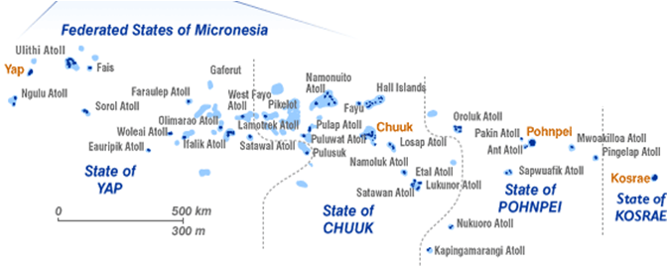
Federated States of Micronesia

Slide 2
Background
An initial technical visit was conducted with support by SPC in 2011. rapid assessment identified that the system requires substantial improvement in all areas
basic mapping of the systems was carried out,
a series of preliminary recommendations
national committee was established.
Follow up TA visit and review with committee 2012 & 2013
Key issues confirmed through mapping and stakeholder engagement. Actions were established, but little progress was made.
National meeting of key stakeholders in 2015 to finalised, assessment and targets were set (support from SPC and ESCAP)

Slide 3
Project implementation
Convened Stakeholders meeting.
Establish CRS committee
Review Legal Framework
Draft CRVS Policy
Standardize automate processes when possible
Development of a CRVS database

Slide 4
Key outputs and outcomes
National Plan of Action for CRVS
Stakeholders gained clear understanding if CRVS and its relation to Human Right Issues
Achieved informed and receptive for the implementation of CRVS
Setting of Targets
Database improvements
Identification of focal point and composition of CRVS committee.

Slide 5
Key outputs and outcome
The targets for Goal 1 as set by Federated States of Micronesia are:
By 2024, at least 95% of births in the territory and jurisdiction in the given year are registered. (current estimates approx. 80%)
By 2024, at least 98% of children under five years old in the territory and jurisdiction have had their birth registered.
By 2024, at least 90% of all individuals in the territory and jurisdiction have had their birth registered.
By 2024, at least 90% of all deaths that take place in the territory and jurisdiction in the given year are registered.
By 2024, at least 100% of all deaths recorded by the health sector (where a doctor is available) in the territory and jurisdiction in the given year have a medically certified cause of death recorded using the international form of the death certificate.

Slide 6
Lesson Learned
The importance of TA (consultation) with stakeholders
The department heads learned first hand the importance of CRVS appreciate their contributions and how it helped with Human Right .

Slide 7
Challenges
Transportation communication and infrastructure
CRVS Legal Framework.
Formally appointing of CRVS committee
New Administration requiring appropriate awareness of the CRVS and the pending needs.

Slide 8
Conclusion and Recommendations
CRVS requires legal framework updates and amendments.
CRVS Formalization
Plan must be established and endorsed at the highest level.

Slide 9
THANK YOU.

