Slide 1
Bhutan’s experience on TA projects in improving national CRVS system

Slide 2
Civil Registration & Vital Statistics Decade 2016-2024
Civil Registration & Vital Statistics Decade 2015-2024
Objective 1: Establish National Coordination Mechanism
Objective 2: Conduct Rapid and Comprehensive Assessment of the CRVS system of Bhutan
Objective 3: Baseline and national targets for CRVS system of Bhutan

Slide 3
Stakeholders Involved
Ministry of Health
Health Information and Management System
Health Research and Epidemiology Unit
Medical Record Officer
Department of Public Health
Legal Unit
Ministry of Home and Cultural Affairs
Department of Civil Registration and Census
Department of Immigration
Legal unit
ICT unit
National Statistics Bureau
Survey and Data Processing Division
Population Housing and GIS Division

Slide 4
Timeline

Slide 5
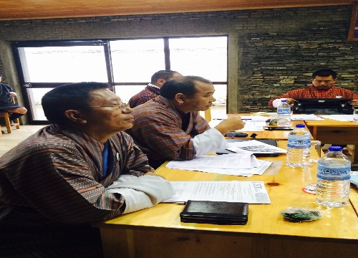
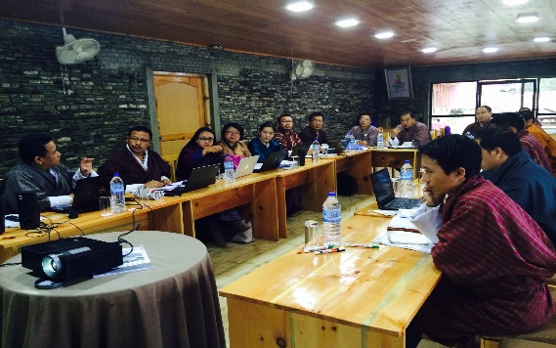
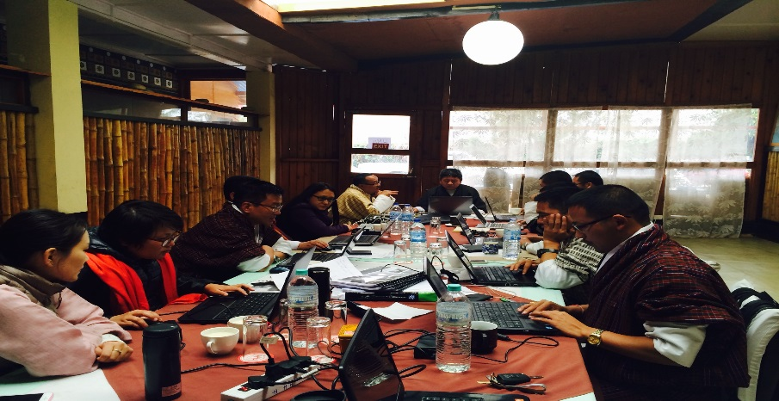
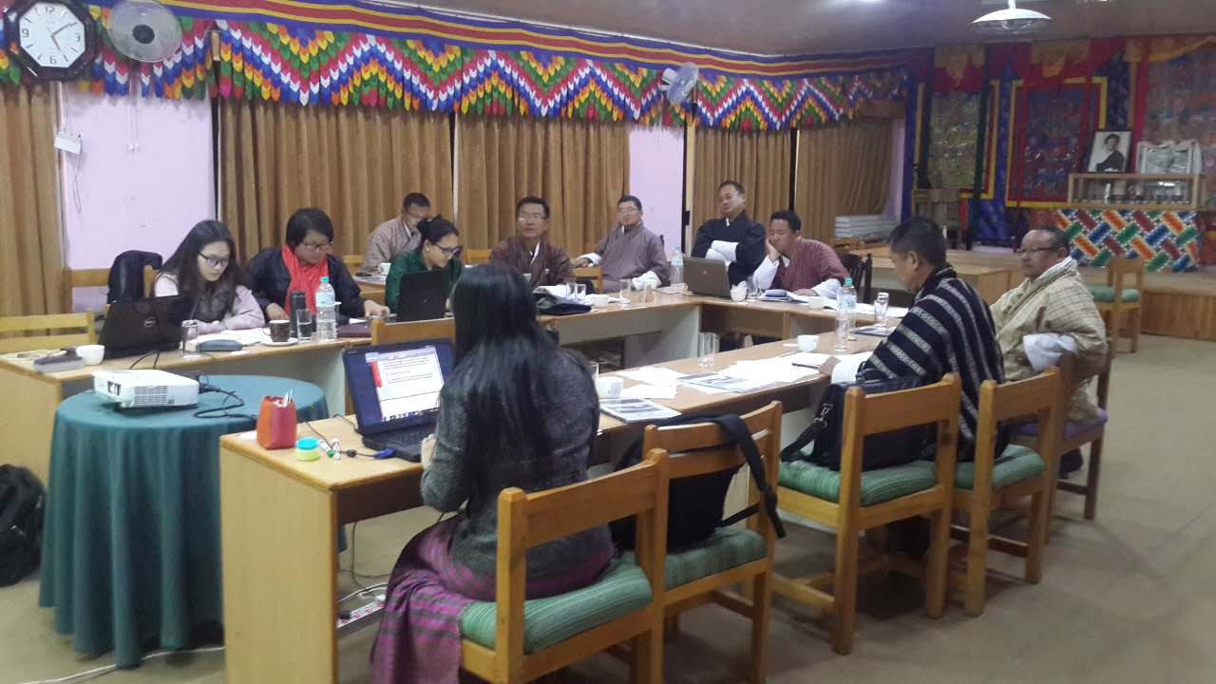
Process of Implementation of the Project
Rapid Assessment of CRVS system 18th-23th March
Comprehensive Assessment of CRVS system, and initial target & baseline setting 24th-30th March
Presentations of draft assessment reports and baseline & targets of CRVS decade for Bhutan to the Directors of Ministry of Health and Ministry of Home and Cultural Affairs, and the representative from GNHC. 31st March 2016

Slide 6
Outcome
Status
Challenges/ Opportunities
Established National Coordination Mechanism
Completed
Getting stakeholders together
Lack of data
Conducted Rapid and Comprehensive Assessment of the CRVS system of Bhutan
Completed
More information on CRVS system of the country
Meeting the stakeholders and sharing of information
Plan to develop CRVS improvement strategy
Baseline and national targets for CRVS system of Bhutan
Completed

Slide 7
Recommendations
Advocating for improved CRVS systems among high-level policy-makers in health and non-health sectors.
Strengthening the existing coordination mechanism of key stakeholders: Ministry of Home and Cultural Affairs (DCRC & DOI), Ministry of Health and National Statistics Bureau.
Training of physicians in cause-of-death certification.
Introducing international standard of verbal autopsy techniques to generate data on cause-specific mortality patterns for deaths occurring outside medical facilities.
Facilitating access to available aggregated data by decision-makers and researchers.
Producing vital statistics including cause-of-death using civil registration and health records annually.
Developing a comprehensive multi-sectoral national CRVS strategy.

Slide 8
THANK YOU & KADRINCHEY!

