Slide 1
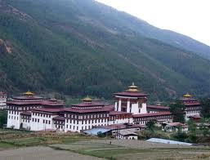
OVERVIEW OF THE CIVIL REGISTRATION AND VITAL STATISTICS (CRVS) SYSTEM OF BHUTAN
Thinley Wangchuk
31 March, 2016

Slide 2
OUTLINE OF THE PRESENTATION
BACKGROUND – CRVS OVERVIEW
LEGAL BASIS FOR THE FUNCTIONING
ORGANISATION CHART FOR CIVIL REGISTRATION AND CENSUS SYSTEM
BIRTH AND DEATH REGISTRATION PROCESS IN BHTAN
REGISTRATION PRACTICES (PAST AND PRESENT)
REGISTRATION PLACE, TIME AND PERSON TO REGISTER

Slide 3
I. BACKGROUND – CRVS OVERVIEW
Till 2001 – Birth and death records were manually compiled in Hard copies (Family Diaries)
2002 – Initiated computerization of birth and death records
2003 – Developed Bhutan Civil Registration System
2009 - Developed guidelines
2010 – Initiated development of Standard Operating Procedure (SOP)
2011 - Initiated web-based registration of Birth and death through online G2C framework from CCs
2015 – Step-by-Step procedure for online application of births and deaths

Slide 4
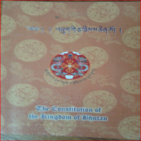
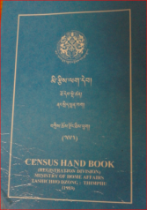
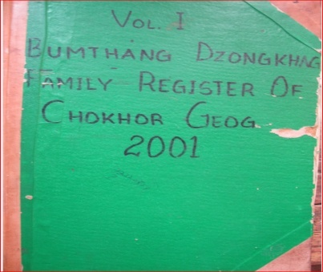
II. LEGAL BASIS FOR THE FUNCTIONING
1
2
3
4
Amendments
5
6
7

Slide 5
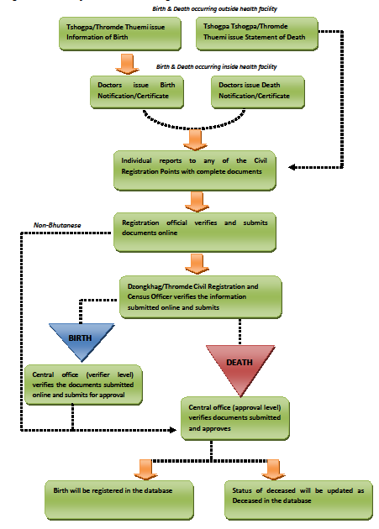
IV. BIRTH AND DEATH REGISTRATION PROCESS

Slide 6
V. REGISTRATION PRACTICES (PAST & PRESENT)
Birth Registration
Past System
Present System
For birth occurring inside heath facility – Registration was done based on ‘Birth Certificate’ issued by Ministry of Health (MoH)
For birth occurring outside heath facility – Registration was done based on information provided in birth reporting form submitted by parents of new born, certified by village representatives and local government authorities confirming the parentage, time and place of birth of a child
The birth registration is now made available through the DCRC web-based framework at www.citizenservices.gov.bt
In the new DCRC web-based framework, birth registration can be carried out either within 30 days of birth of a child from the place of residence/occurrence or before the conclusion of the annual birth and death registration.
In the event of failure to register births even during the time of the annual census (November-January), such cases will then have to be reported to the Department of Civil Registration and Census Head Quarters for further verification and submission to the Ministry for approval.
In a new System, Births occurring outside health facilities, Tshokpas and local leaders shall issue Information on Birth and based on this statement, Hospitals shall issue notification of Birth

Slide 7
CONTD…
Death Registration
Past System
Present System
For death occurring inside heath facility – Registration was done based on ‘Death Certificate’ issued by MoH
For death occurring outside heath facility – Registration was done based on death report submitted by parents/guardian/next of kin of the deceased in the death reporting form certified by local government authorities confirming the death of a person
Death registration is now made available through the DCRC web-based framework at www.citizenservices.gov.bt
In the new DCRC web-based framework, death registration can be carried out within 30 days of death of a person from the place of residence/occurrence
If the registration of death is not carried out within 30 days, such cases will have to be reported to the concerned Dzongkhags where the deceased person’s census/marriage case is registered
In a new System, Deaths occurring outside health facilities, Tshokpas and local leaders shall issue statement of death and based on this statement, Hospitals shall issue notification of death

Slide 8
VI. PLACE, TIME AND PERSON TO REGISTER
Past System
Present System
Place:
Community Centres
Dungkhag Civil Registration Offices
Thromde Civil Registration Offices
District Civil Registration Offices
DCRC HQ
Time:
Any time of the Year within 30 days
Whom:
Bhutanese citizen and Residence Permit Holders
Place:
Gewog (Block) centres
District Civil Registration Offices
DCRC HQ
Time:
November – January (Annual Census)
Whom:
Bhutanese citizen and Residence Permit Holders

Slide 9
KADRIN-CHEY

