Slide 1
Overview of the Development Account Project
Regional workshop on outcomes and lessons learnt from technical assistance projects in support of improving CRVS systems
Bangkok, Thailand
18 April 2016

Slide 2

Development Account Projects
The Development Account (DA) was established by the General Assembly in 1997 as a mechanism to fund capacity development projects in the priority areas of the United Nations Development Agenda that benefit developing countries.

Slide 3
The focus of the project
“Strengthening the capacity of Civil Registration and Vital Statistics (CRVS) Systems in Africa, and Asia and Pacific regions to produce continuous and reliable indicators for measuring progress on the development indicators”
Implemented by the Economic Commission for Africa and ESCAP together with development partners (SPC, WHO, ABS, University of Queensland etc.)
Notes:
Based on reports received by 8 April 2016.

Slide 4
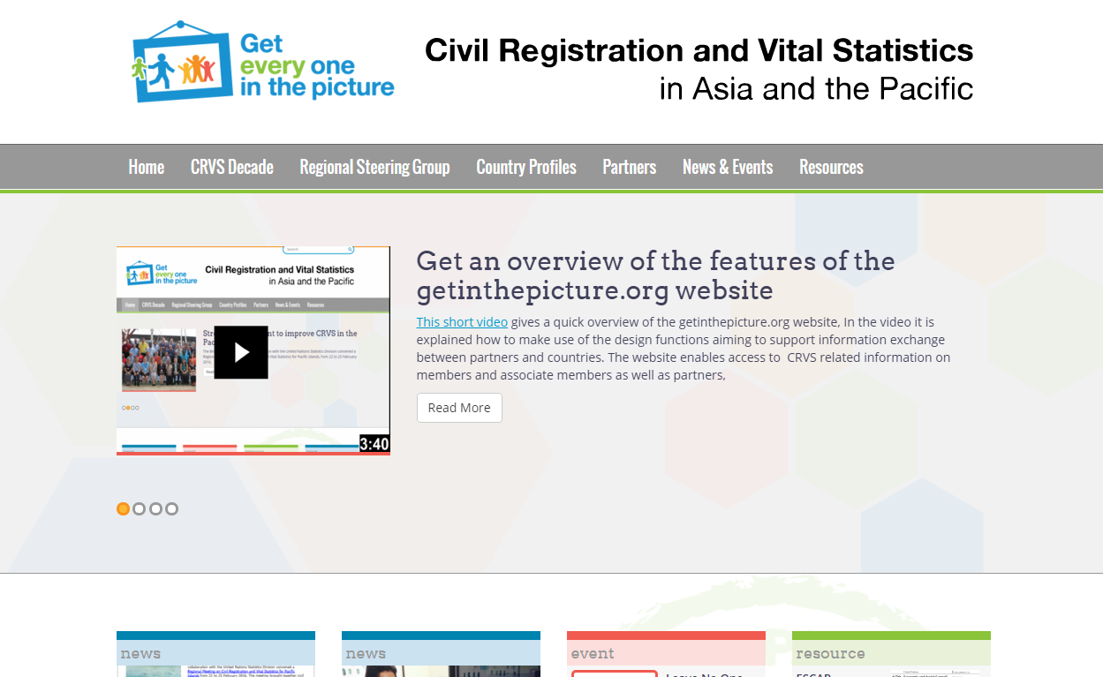
Activities as part of the project
Support Regional Steering Group meeting (2015)
Develop guidelines for setting and monitoring goals and targets
New website
Training on vital statistics for selected countries (2015)
Publish advocacy materials
Support meeting on CRVS in the Pacific (2016)
Develop training materials for producing vital statistics from civil registration records (ongoing) and EGM to validate these (2016)
Country grants and workshop

Slide 5



Country grants
5 country grants were distributed to support ongoing CRVS improvement activities at the country level (aligned with Regional Action Framework implementation)
The specific technical activities undertaken reflected the national priorities of the beneficiary countries
To promote the exchange and transfer of skills, knowledge and good practices among target countries within and between different geographic regions, this workshop will focus on the outcomes and lessons from these projects.
Notes:
FSM, No target set

Slide 6
Thank you!
For more information, please visit: www.getinthepicture.org

