Slide 1
Baseline data and national targets for the Asian and Pacific Civil Registration and Vital Statistics Decade
Bangkok, Thailand
18 April 2016

Slide 2
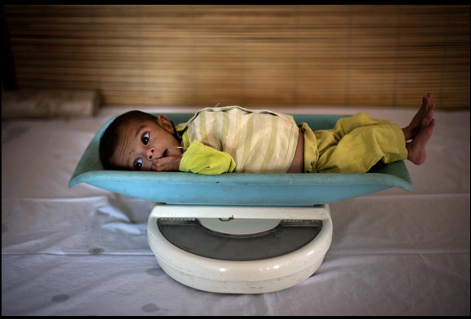
Implementation steps
National CRVS coordination mechanism
Conduct a comprehensive assessment
Set the national target value for each target
Assess inequalities related to CRVS experienced by subgroups of the population, and, where appropriate, set national targets to address those inequalities
Comprehensive multi-sectoral national CRVS strategy
Assign a national focal point
Report relevant information to the ESCAP secretariat

Slide 3
Overview of implementation step status (April 2016)
Notes:
Based on reports received by 8 April 2016.

Slide 4
Overview of implementation steps
 | Armenia | Bhutan | FSM | Kiribati | Philippines
Coordination Mechanism | In progress | √ | √ | √ | √
Assessment | In progress | √ | √ | √ | √
National targets | √ | √ | √ | √ | √
Monitoring and reporting plan | In progress
Inequality assessment |  |  |  | √ | √
CRVS strategy | In progress | In 2017 | In progress | √ | In progress
Focal point | √ | √ |  | √ | √
Reporting to ESCAP | √ | √ | √ | √ | √

Slide 5



Target setting in countries
Most countries have set very ambitious targets across the goals, including for universal or close to universal registration of both births and deaths
(Between 90 and 100 per cent for countries here)
The majority of countries are aiming for 100 of registrations to be accompanied by certificates, although almost 1/3 countries did not set targets under goal 2 (100 per cent for all except FSM)
Targets under goal 3 diverge substantially. Main issue highlighted is lack of implementation of ICD.
Countries here have highlighted a need for more work on timely production and dissemination of vital statistics
Notes:
FSM, No target set

Slide 6
Baseline data for the Decade
Many countries have had difficulties establishing baselines, in particular for targets under Goal 1 (universal registration) and Goal 2 (legal documentation) –This is not the case for countries participating here
Some paper based systems still exist -none of the participating countries
Registration of Cause of Death particularly problematic -also an issue for participating countries
Vital Statistics reports not available in all countries --also an issue for participating countries

Slide 7
Thank you!
For more information, please visit: www.getinthepicture.org

