Slide 1
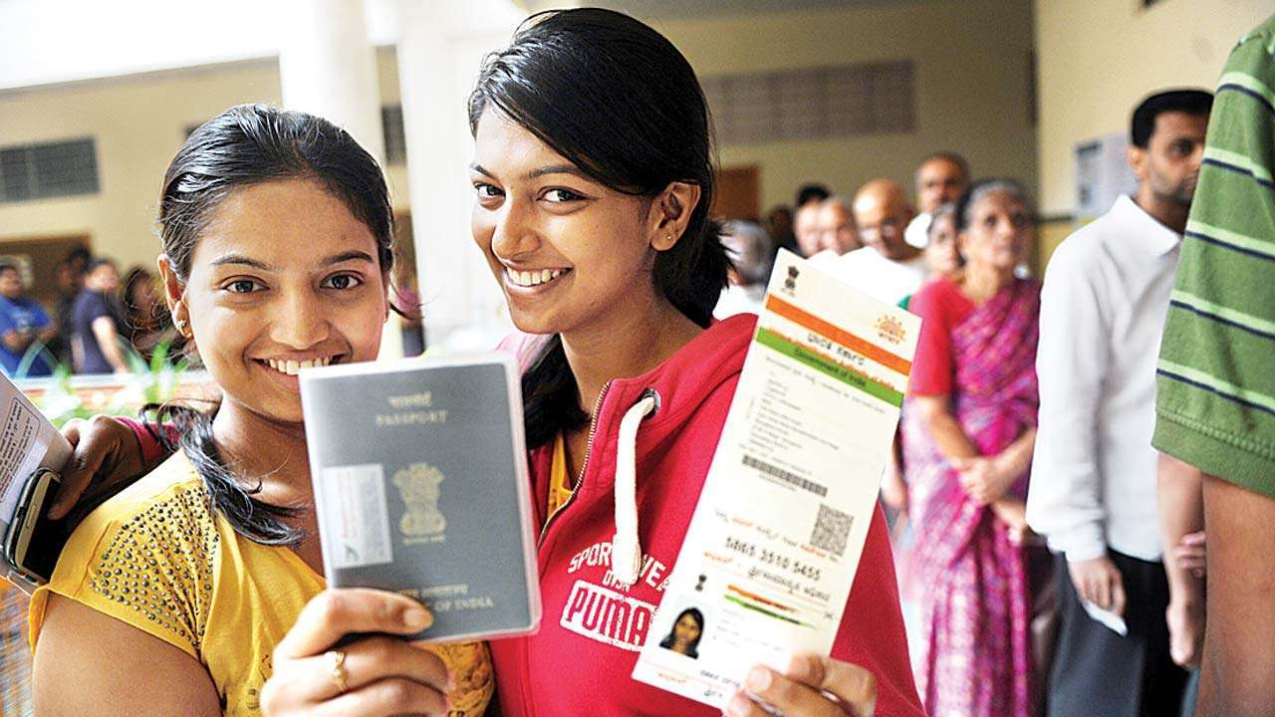
Digital ID in Asia and the Pacific
Jonathan Marskell
jmarskell@worldbank.org
id4d.worldbank.org

Slide 2
1. Introduction

Slide 3
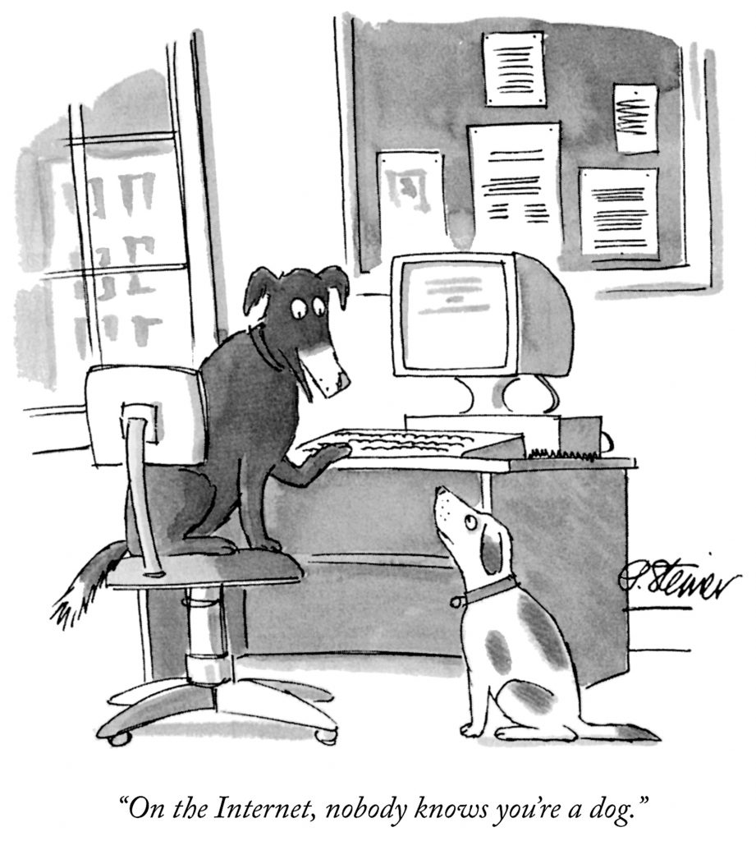
All transactions depend on trust between parties, including in each other’s identity.
In today’s age of digital and wider societies, new mechanisms are needed.
Historically, people’s identity was verified through familiarity or taking documents at their face value.

Slide 4
ID systems are a foundational platform for the digital economy, across sectors
PAKISTAN: NADRA linked BISP payments to female HOH and had 12 female only enrollment centers; increased female enrolment by 100% from 2008 - 2014
INDIA: 73m new bank accounts opened using eKYC; 472m accounts linked with Aadhar
THAILAND: Universal birth registration enables stateless children to attend school
PERU: ID verifies beneficiaries to access universal health insurance, and enables tracking of vaccines
Financial inclusion
Women’s empowerment
Social protection
Removing barriers through eKYC
Digital payments interoperability
Enhanced credit reporting
Direct payments & transfers to women in the household
Enforcing child marriage laws
Better targeting of beneficiaries
Information systems integration
Eliminating leakages
Health
Regional integration
Education
Health insurance for UHC
Unique ID for healthcare delivery & tracking, incl. vaccinations
Safe & orderly migration
Cross-border e-commerce and services
Removing barriers to enrolment
Improving EMIS
Digital ID Systems (integrated with civil registration)

Slide 5
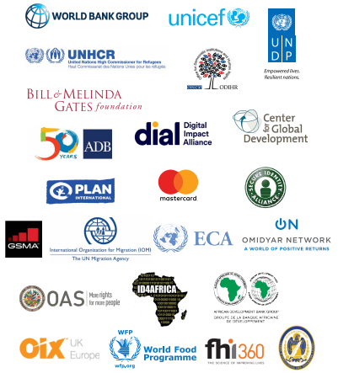
Principles on ID for Sustainable Development: A framework of best practices
Inclusion:
Universal Coverage and Accessibility
Ensuring universal coverage for individuals from birth to death, free from discrimination.
Removing barriers to access and usage and disparities in the availability of information and technology.
Establishing a robust—unique, secure, and accurate—identity.
Creating a platform that is interoperable and responsive to the needs of various users.
Using open standards and ensuring vendor and technology neutrality.
Protecting user privacy and control through system design
Planning for financial and operational sustainability without compromising accessibility.
Safeguarding data privacy, security, and user rights through a comprehensive legal and regulatory framework.
Establishing clear institutional mandates and accountability.
Enforcing legal and trust frameworks though independent oversight and adjudication of grievances.
Design:
Robust, Secure, Responsive, and Sustainable
Governance:
Trust, Privacy, and User Rights
Endorsed by 25 organizations

Slide 6
2. Status of digital ID in Asia and the Pacific

Slide 7
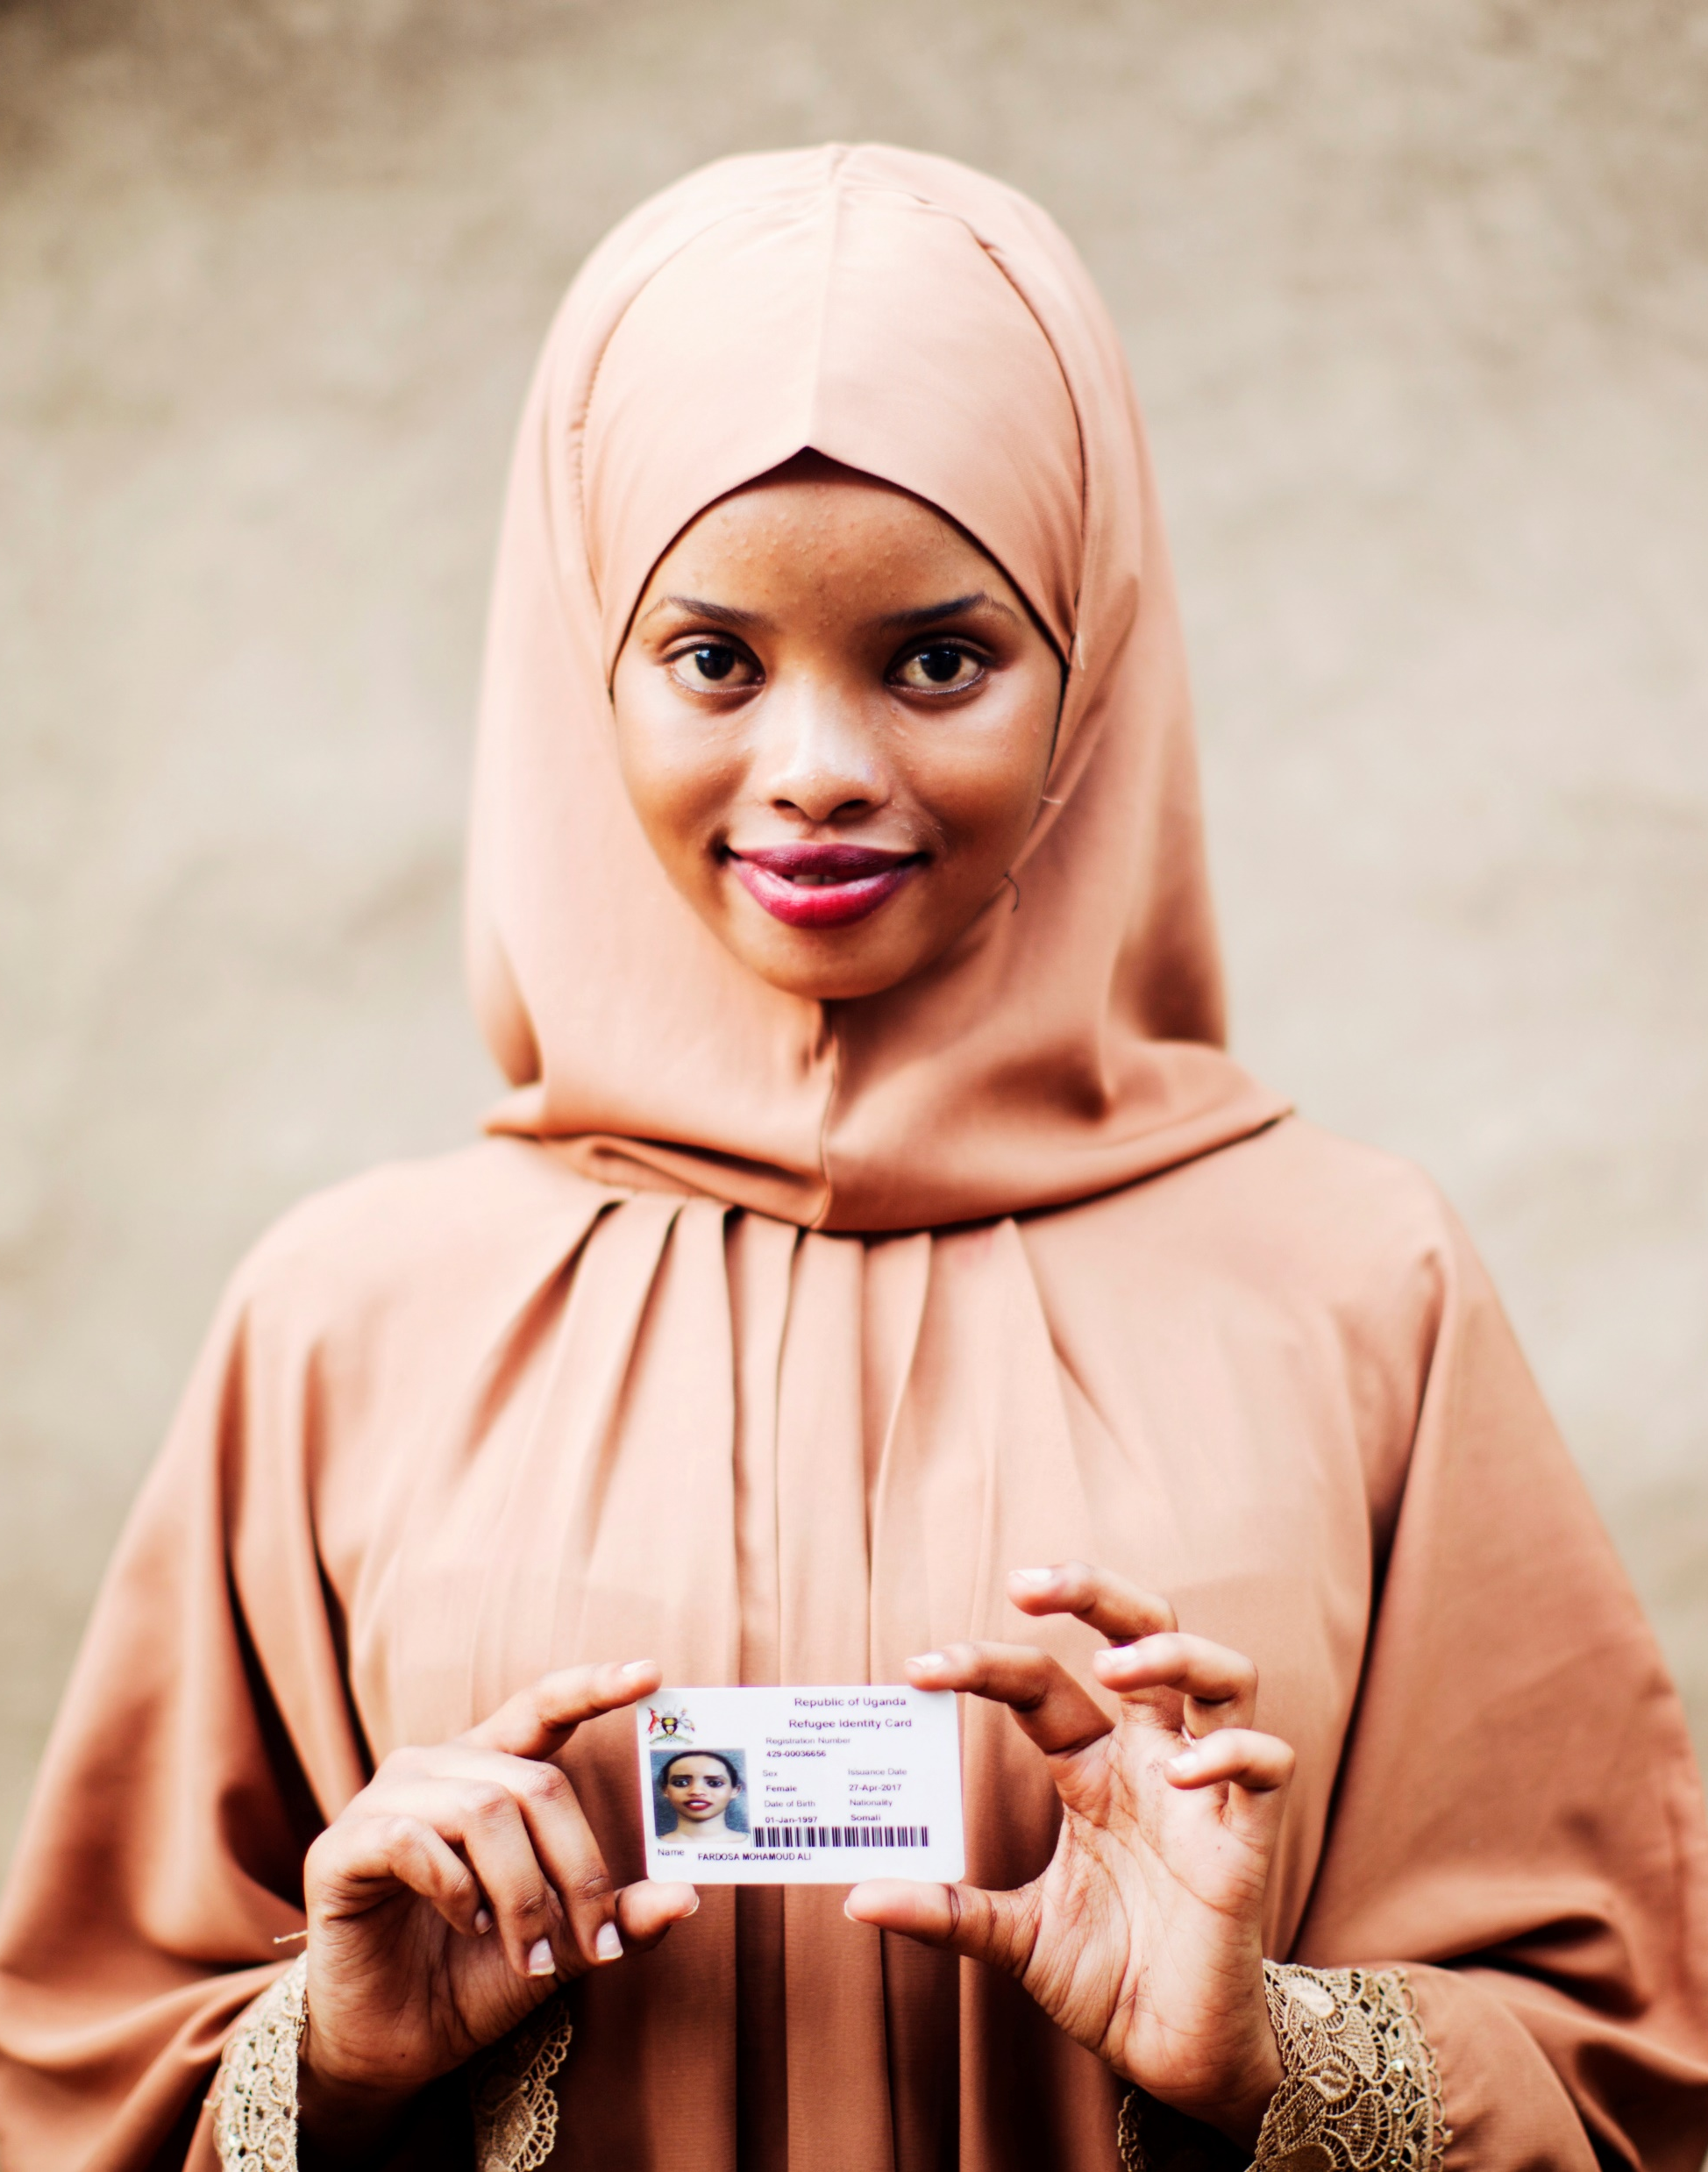
Source 1: 2018 WBG ID4D Dataset
Globally, an estimated 1 billion people have no official ID
Within Asia and the Pacific, this figure is 398 million (15% of the total population)
…they face major challenges exercising their rights and accessing services.

Slide 8
Source 2: 2017 Findex Survey (Adults)

Slide 9
A large number of countries are making substantial progress
Introducing new digital ID systems (examples)
Australia
Japan
Myanmar
Nepal
Papua New Guinea
Philippines
Samoa
Vanuatu
Upgrading existing digital ID systems (examples)
Afghanistan
Cambodia
Kyrgyz Republic
Singapore
Sri Lanka
Thailand
Uzbekistan
Viet Nam

Slide 10
3. Implications for ‘Get Every One in the Picture’

Slide 11
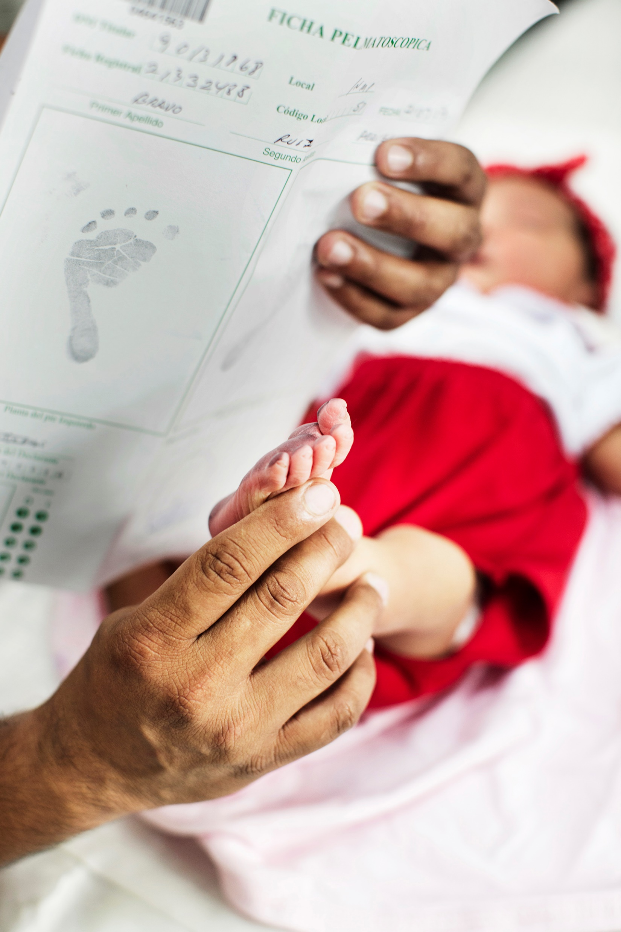
1. Integrating CR and digital ID systems
Not a zero-sum game nor requires sequencing: In fact, they are mutually-reinforcing.
Encouraging integration and developing practical guidance on “how”:
Births: Creating a lifelong digital ID at the same time as BR (for the ‘flow’), including assigning a unique ID number (see ID4D guidance published already)
Deaths: Exchanging data to ‘deactivate’ digital IDs of deceased persons
Infrastructure: Sharing, where appropriate
Stock and flow approach: For countries with weak CR introducing digital ID systems

Slide 12
2. (Sub) Regional approach to digital identity
Cross-border interoperability: Facilitating economic integration through easier trade, e-commerce and migration, e.g.:
Africa: UNECA / African Union
Europe: eIDAS
Latin America: MERCOSUR
Creating regional norms: Agreeing on standards, harmonization of laws and regulations (e.g. ID, e-transactions)
Perhaps starting at the sub-regional level: ASEAN, South Asia, Central Asia, Pacific islands

Slide 13
3. Privacy and data protection
An urgent challenge: For both CRVS and digital ID systems, including to provide greater control to end-users
Promoting comprehensive enabling legal frameworks and ‘privacy by design’: Developing regional norms and standards, facilitating knowledge exchange, and capacity-building, drawing on:
International best practices: EU GDPR; Philippines and Korea data protection laws; ‘Privacy by Design’ principles; Principles on ID for Sustainable Development
Work of ID4D: IDEEA legal assessment tool; ‘Mission Billion’ innovation challenge

Slide 14
Annex

Slide 15
Annex: Stock and Flow model for registration
The Stock (People alive today)
Digital ID and UIN provided after registration with birth certificate / record as evidence, if they have one.
Alternative evidence accepted to prevent exclusion.
No need to register birth retroactively.
Digital ID system / Population registry
Civil registry
Registration of deaths.
The Flow (Children today [e.g. up to 5 years] and born from tomorrow)
Digital ID, including UIN, provided through birth registration.
Biometrics collected at appropriate age, if necessary.
Registration of other vital events

