Slide 1
Report of the Task Force on Mortality: Identifying gaps in death registration systems in the ESCAP Region Dr.Lene Mikkelsen University of Melbourne

Slide 2
Improving national capacity, skills and knowledge of the importance of mortality data
The last decade has seen a number of important regional initiatives that aims at improving the functioning of CRVS systems
Even philanthropies like the Gates and Bloomberg’s Data for Health have invested into strengthening CRVS and health information systems
The ESCAP Regional Action Framework on CRVS in the Asia and the Pacific has set the lead for other regions and is the reason we are here today
In preparation of the mid-term review the Regional Steering Group last year created a Task Force to specifically look into capacity development and supply of cause of death information in countries in the region

Slide 3
Outline of presentation
Why a Taskforce on mortality and causes of death (COD)?
Task Force activities
Survey results
Conclusions

Slide 4
Main challenges with mortality data
Incomplete registration of deaths (less so for births)
Poor certification of the cause of death
Poor availability/timeliness of data
Poor quality of existing data
Poor understanding of the true value of reliable CoD data
Vast and unacceptable uncertainty in rankings of leading causes of death and how they are changing

Slide 5
Why is it important that countries improve their death reporting systems?
Policies should always be informed by accurate and timely data to ensure correct allocation of resources
Availability of data does not guarantee quality
Public health policy nationally and subnationally should be guided by evidence
You cannot monitor interventions in the health systems with poor data
Disease and injury patterns are not static, funding of disease groups should correspond to their current relevance
14 SDG indicators require cause-specific mortality data for monitoring

Slide 6
Why is COD data difficult to collect?
In countries where most people die outside hospitals the COD, if collected, is not medically certified
COD data are complex. Potential for errors, biases, omissions etc. exist at many levels of a CRVS system
ICD coding of COD has to be done by properly trained coders
Hence many countries globally struggle with collecting COD data of sufficient use for policy
Notes:
COD information is complex, needs to be certified by a medical doctor who knows how to certify correctly and fill in the form. Often he has not been trained in doing so, not attended or even seen the patient. Community death are often not certified or it is done by a lay person, children and infant are often not registered at all. Indigenous and marginalised populations are severely under-registered. In the coding process which follows the coder may not be able to select the correct underlying cause and give the accurate code.

Slide 7
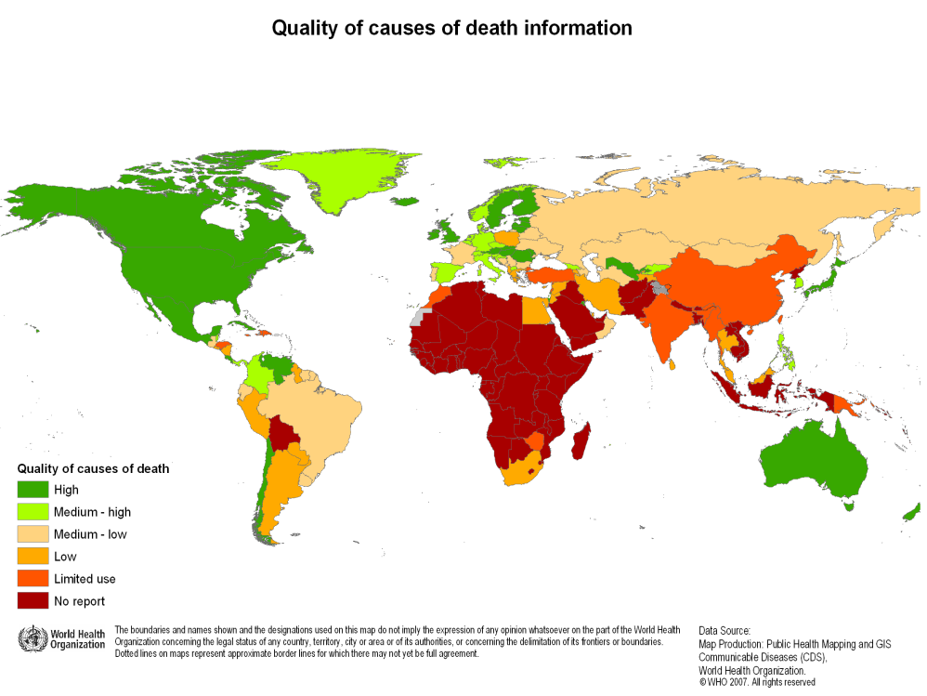

Slide 8
Classification of global VS systems based on VSPI

Slide 9
What is the VSPI made up of?

Slide 10
Example of progress in VS

Slide 11
Welcome to the ANACONDA Tool
Notes:
Once you have downloaded the software you get this welcome screen
Chose the language of the tool: English, Portuguese, Spanish, Russian or Chinese
Three buttons according to whether you are new to ANACONDA, want to enter some data for assessment or just want to access an assessment previously done.

Slide 12
Death distributions on 3 broad cause groups, Iran 2015

Slide 13
Leading causes of death, Males 2014

Slide 14
Leading causes of death in Philippines 1990 and 2016

Slide 15
Task Force and mandate
WHO and D4H co-chaired the Task force and other active members were BAG, EMRO, SEARO, WPRO and Fiji.
Our ToR included:
identifying gaps in death registration systems & generation of statistics
Supporting countries in providing advice and strategic directions
Engaging the health sector in improving registration
Promoting best practices and tools
Collaborating with international partners
Our outputs this year:
Survey on gaps and needs
Based on that we will produce a report on the situation of COD data in the region which can guide the improvement work

Slide 16
Description of survey
We wanted our report to be as up-to-date and evidence-based as possible. Hence the questionnaire to countries to identify critical gaps in their :
Death registration and notification practices (7 Q)
International norms and standards (8 Q)
Statistical output from their systems (7 Q)
To cover these areas comprehensively we would have needed many more questions than the 19 we settled for, but that would have been too heavy a burden for respondents
The questionnaire was sent to all ESCAP members except those who had well-functioning systems
We are very thankful for the 22 replies we got, which represent all regions except the Russian speaking ones

Slide 17
What did we learn from the survey?
Based on the replies to the questions in the survey countries can be grouped into three types according to gaps/weaknesses
6 countries had many gaps in all 3 areas
7 countries had some gaps in most areas
For the remainder it was mostly improvement in quality which was needed in several areas

Slide 18
Country grouping based on replies to survey
Countries | Most gaps | Some gaps | Least gaps
Afghanistan
Bhutan
Indonesia
Lao PDR
Nepal
Solomon Islands
India
Marshall Islands
Philippines
Sri Lanka
Tonga
Vanuatu
Bangladesh
Cook Islands
DPR Korea
Fiji
Iran
Maldives
Nauru
Niue
Thailand
Turkey

Slide 19
Death registration results
 |  |  |  |  |  | Not answered
Yes | Completeness 75+ | No | < 30% Completeness | Partially | Completeness 30-74%
 | Designated CR agents |  |  | Notifying deaths |  |  | Home deaths |  |  | Burial permit |  |  |  | MCCoD legal require | Without MCCoD | Est. completeness
 | Inside HF | Very close to HF | Govt. office | Village leader | CHW | Other | To hospital | Physician exam | none | MOH | MOF/SW | MOI/MHA | Other
Afghanistan
Bangladesh
Bhutan |  |  |  |  |  |  |  |  |  |  |  |  |  |  |  | 75+
Cook Islands |  |  |  |  |  |  |  |  |  |  |  |  |  |  |  | 75+
DPR Korea |  |  |  |  |  |  |  |  |  |  |  |  |  |  |  | 75+
Fiji |  |  |  |  |  |  |  |  |  |  |  |  |  |  |  | 75+
India |  |  |  |  |  |  |  |  |  |  |  |  |  |  |  | 75+
Indonesia
Iran |  |  |  |  |  |  |  |  |  |  |  |  |  |  |  | 75+
Lao PDR
Maldives |  |  |  |  |  |  |  |  |  |  |  |  |  |  |  | 75+
Marshall Islands |  |  |  |  |  |  |  |  |  |  |  |  |  |  |  | 75+
Nauru |  |  |  |  |  |  |  |  |  |  |  |  |  |  |  | 75+
Nepal |  |  |  |  |  |  |  |  |  |  |  |  |  |  |  | 35-49
Niue |  |  |  |  |  |  |  |  |  |  |  |  |  |  |  | 75+
Philippines |  |  |  |  |  |  |  |  |  |  |  |  |  |  |  | 75+
Solomon Islands |  |  |  |  |  |  |  |  |  |  |  |  |  |  |  | <10
Sri Lanka |  |  |  |  |  |  |  |  |  |  |  |  |  |  |  | 75+
Thailand |  |  |  |  |  |  |  |  |  |  |  |  |  |  |  | 75+
Tonga
Turkey |  |  |  |  |  |  |  |  |  |  |  |  |  |  |  | 75+
Vanuatu |  |  |  |  |  |  |  |  |  |  |  |  |  |  |  | 34

Slide 20
What did the survey reveal about death registration practices?
Only 5 countries did not have registration agents, mostly (12) placed in health facilities or nearby
In most countries home deaths could be notified by village leaders, health workers or others
In half the countries the dead body was brought to either the hospital or was certified by a doctor at home
Burial permits were necessary in all but 6 countries and in 8 was it a requirement to include a MCCOD
For community deaths only 6 countries required a MCCOD
14 countries estimated that they registered +75% of all deaths

Slide 21
International standards
 |  |  |  |  |  | Not answered
Yes | Medical certified 75+ | No | Medical certified < 30% | Part. | Medical certified 30-74%
 | International standards | Version | No. of lines | Authorized to sign
 |  |  |  | Medical Officers | Medico-legal | Nurses | Other | % Death MC | Hos. Deaths notified CR | ICD version | ICD in all
Afghanistan |  | 2016 | 4 |  |  |  |  |  |  | 10
Bangladesh |  | 2016 | 4 |  |  |  |  | 10-19 |  | 10
Bhutan |  |  | 3 |  |  |  |  |  |  | 10
Cook Islands |  | Old | 4 |  |  |  |  | 75+ |  | 10
DPR Korea |  |  | 4 |  |  |  |  | 75+ |  | 10
Fiji |  | 2016 | 4 |  |  |  |  | 75+ |  | 10
India |  | Old | 3 |  |  |  |  | 10-19 |  | 10
Indonesia |  | Old | 3 |  |  |  |  |  |  | 10
Iran |  |  | 4 |  |  |  |  | 75+ |  | 10
Lao PDR
Maldives |  | Old | 4 |  |  |  |  | 75+ |  | 10
Marshall Islands |  | Old | 3 |  |  |  |  |  |  | both
Nauru |  | Old | 3 |  |  |  |  | 75+ |  | 10
Nepal |  |  |  |  |  |  |  |  |  | 10
Niue |  | Old | 4 |  |  |  |  | 75+ |  | 10
Philippines |  | Old | 3 |  |  |  |  | 75+ |  | 10
Solomon Islands |  | Old | 4 |  |  |  |  |  |  | 10
Sri Lanka |  | Old | 4 |  |  |  |  | 50-65 |  | 10
Thailand |  | Old | >6 |  |  |  |  | 50-64 |  | 10
Tonga |  | Old | 4 |  |  |  |  | 75+ |  | 10
Turkey |  | 2016 | >6 |  |  |  |  | 75+ |  | 10
Vanuatu |  | Old | 4 |  |  |  |  | 35-49 |  | 10

Slide 22
How well were the international standards followed?
All but 5 countries said that they used the international standard death certificate
But only 3 countries used the latest version
6 counties only had 3 lines for reporting what led to the person dying
In 8 countries other than a doctor could sign the medical death certificate

Slide 23
How well were the international standards followed? (cont.)
Half the countries estimated that at least 75% of their deaths were medically certified, in almost all of these the hospitals provided death lists to the CR system
All but two countries used the ICD-10
But only half of the countries had implemented ICD in all their health facilities

Slide 24
Statistical output of their VS system

Slide 25
What did the survey show about the availability of COD statistics?
All but 3 countries had some database on COD, mostly located in the MoH or in the Central Statistical Office
Most common way of disseminating the data was through annual reports, but one third also use the web
The COD data are usually broken down by age and sex, except 4 countries that have no sex and 3 no age
The ICD breakdown is provided in some shortlist in 11 countries while in the rest a more detailed ICD list is used

Slide 26
What did the survey show about the availability of COD statistics? (cont.)
16 countries said that they compile the COD data by some regional/administrative breakdowns
Warning! availability of data does not guarantee sufficient quality for policy use
Monitoring the SDG will mean an additional effort is necessary even for those countries which have the data

Slide 27
Conclusions
Much work will still be needed in countries to reach their goals by the end of the CRVS decade
Fortunately big progress has happened in knowledge of what needs to be done in the different areas needing improvement
The report we will repair will lists the key tools available to countries to close their CRVS gaps in the mortality area
Direct support to countries are also available in form of big progress in technical expertise in the region, located outside the international organisations, e.g. In countries, D4H, universities, NGOs, etc.
The full support from all the partners, including members of the Regional Steering Group, will be vital to ensure that goals are reached in the Asia-Pacific region
ESCAP’s role as secretariat, CRVS forum, coordinator of expertise will continue to be crucial

Slide 28
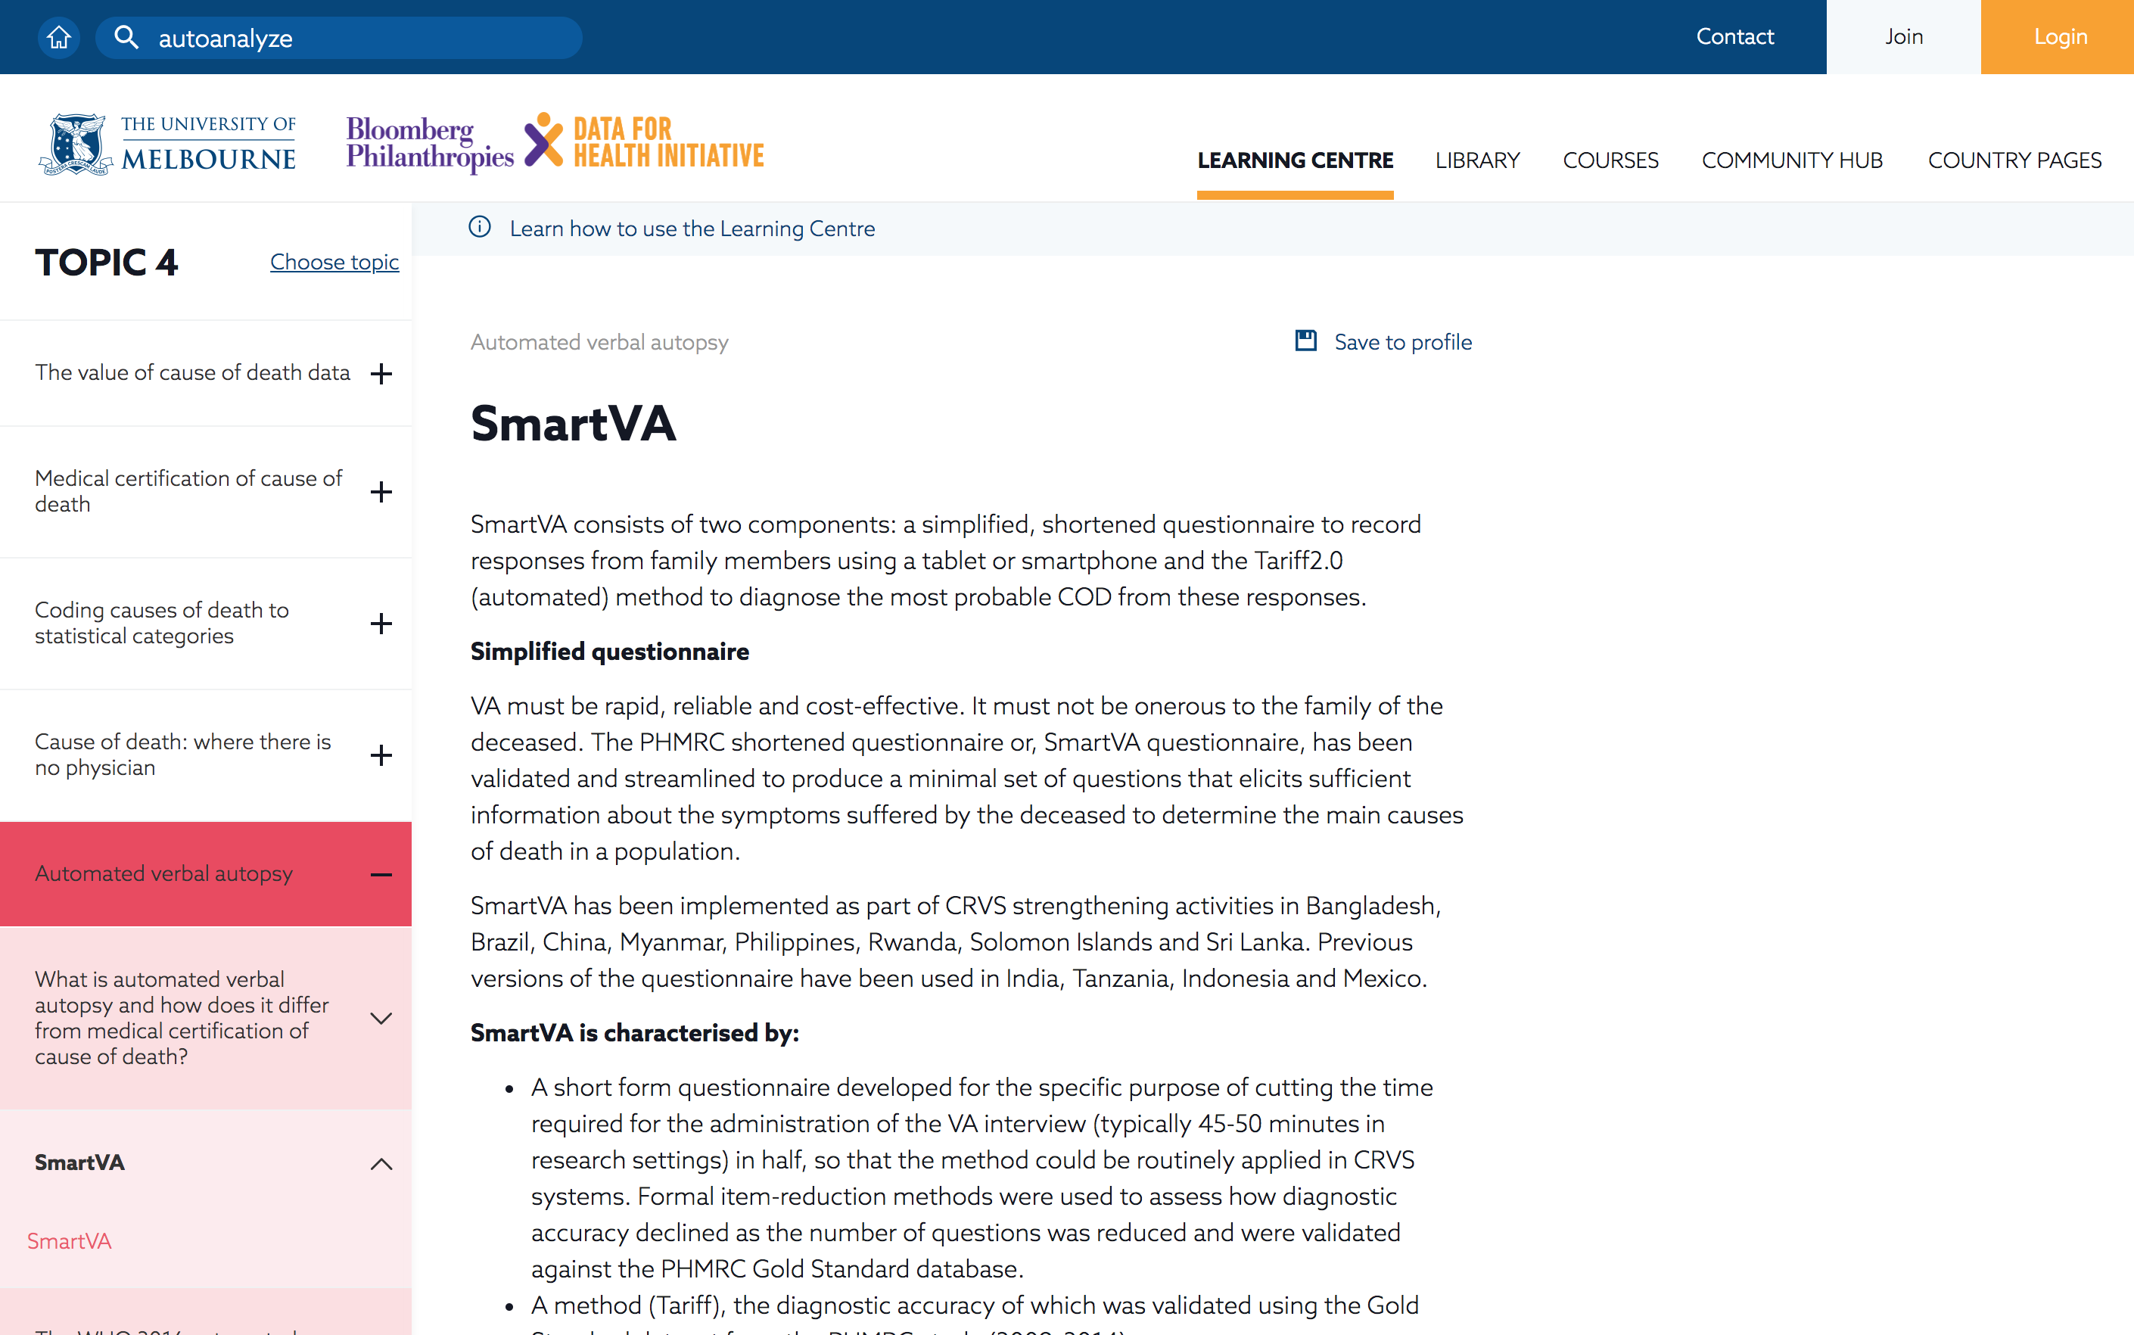
Learning Centre

Slide 29
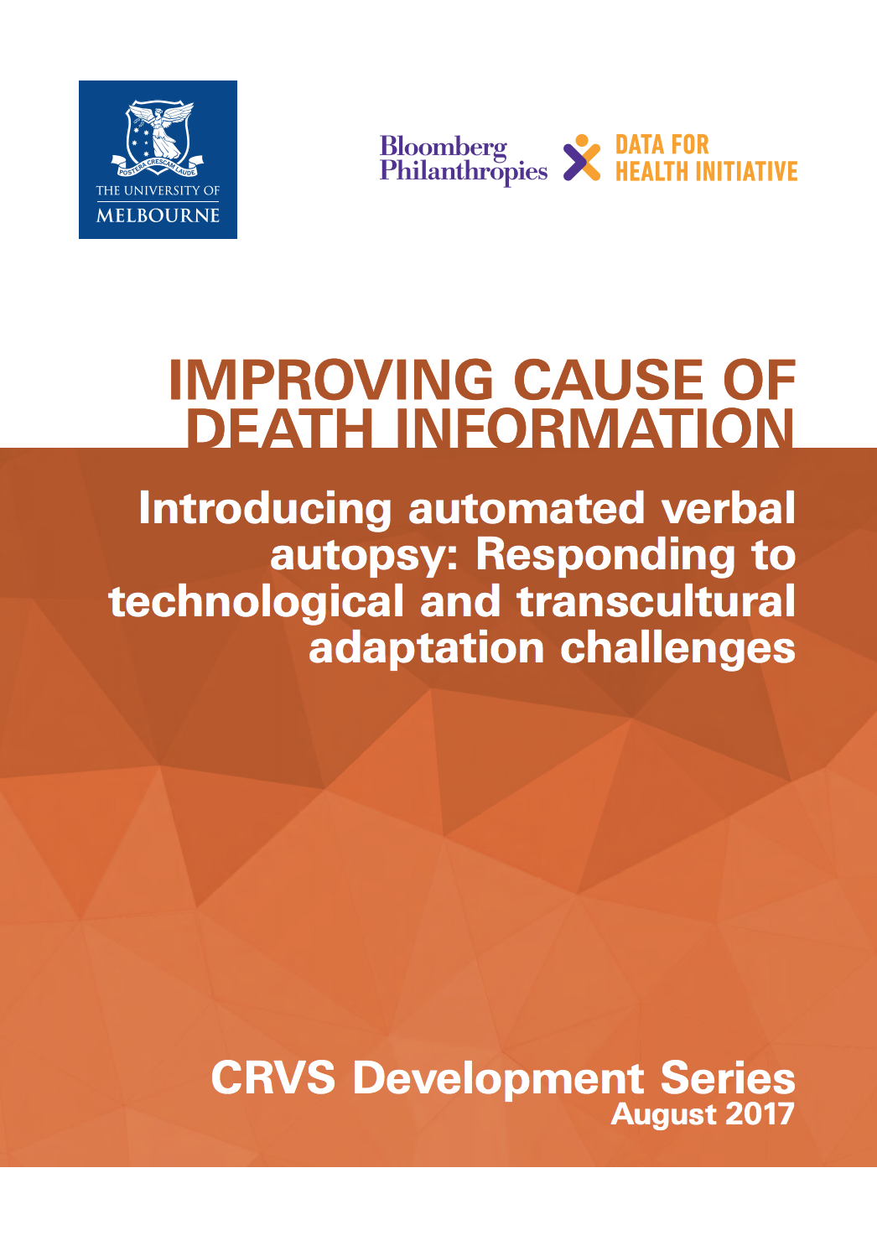
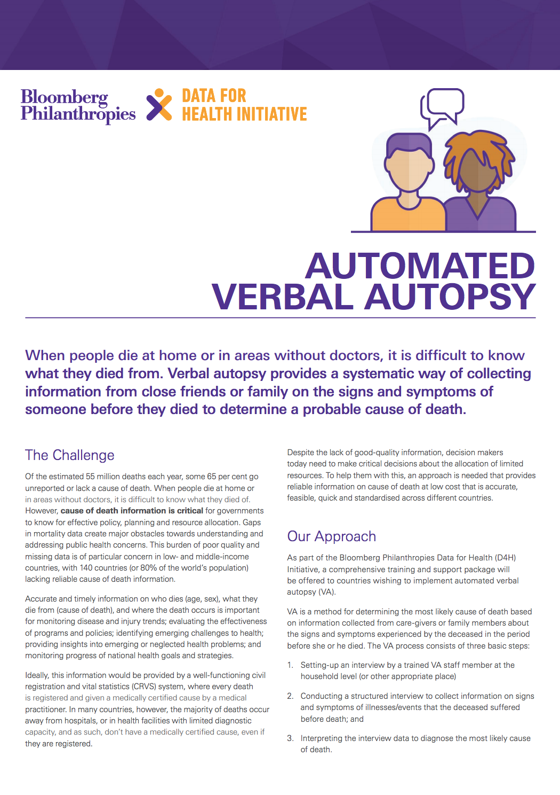
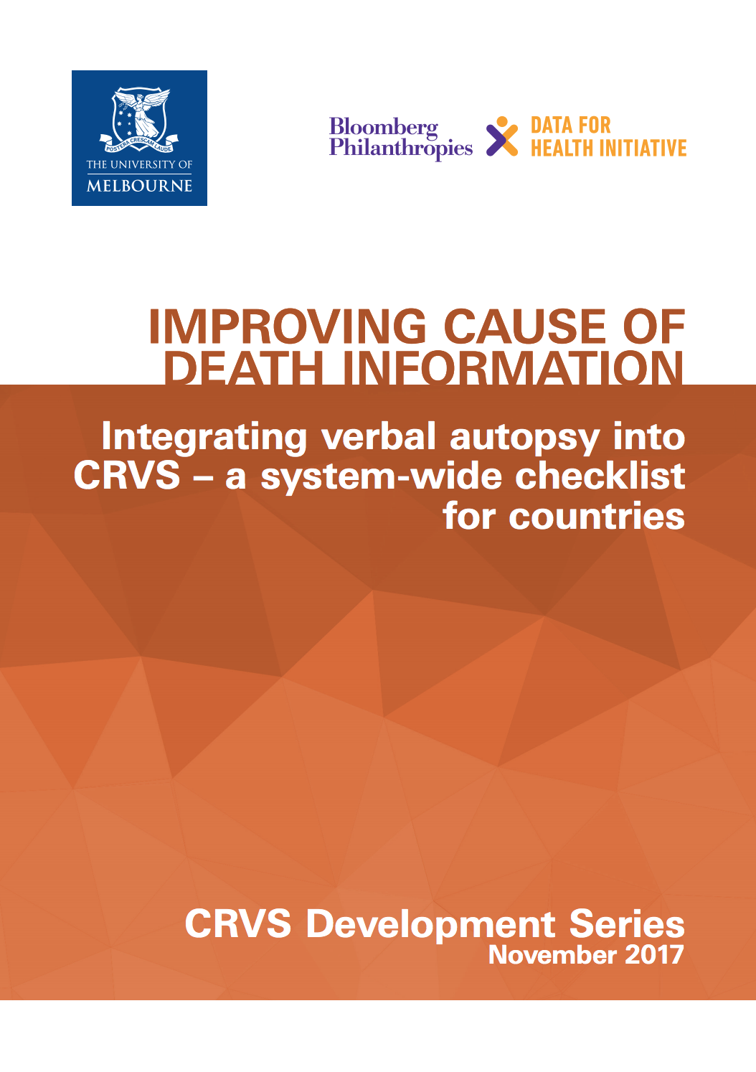
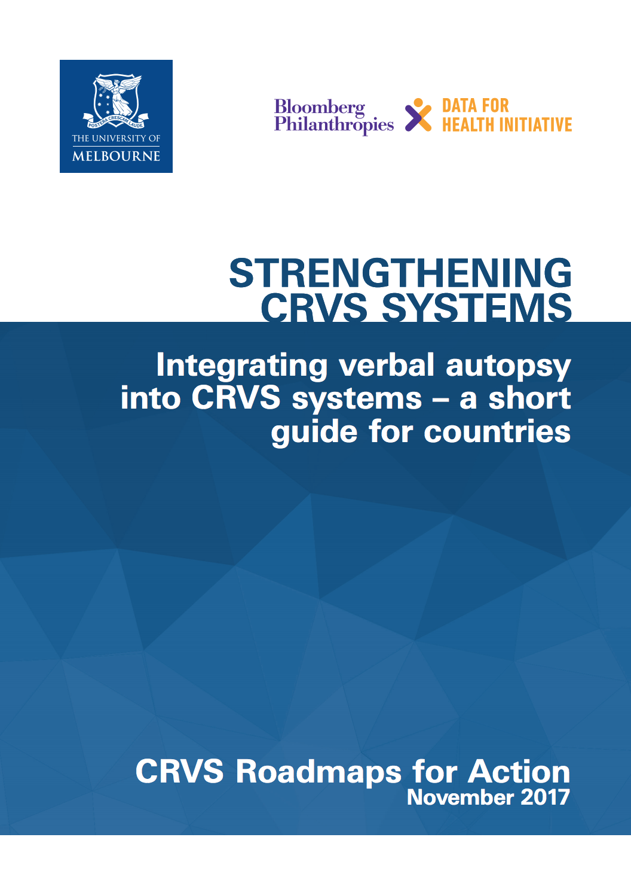
Library
www.crvsgateway.info/library

Slide 30
Our website
www.crvsgateway.info

