Slide 2
Iran’s experience filling the baseline report

Slide 3
Main national stakeholders (Who are the national stakeholders engaged in CRVS activities?)
As CRO: National Organization for Civil Registration (NOCR)
As Health Sector: Ministry of Health and Medical Education (MOHME)
As NSO: Statistical Centre of Iran (SCI)
Other relevant stakeholders such as: Ministry of Interior, Municipals, Legal Medicine Organization, I.R. Iran Medical Council, Ministry of Foreign Affairs (Consulates: for abroad Iranians), Universities, Ministry of Agriculture , Ministry of Education , Ministry of culture, …

Slide 4
International Development Assistance (Supports for national CRVS activities are received from:)
WHO
UNFPA
UNICEF

Slide 5
Specific Tasks/Studies needed to fill the report

Slide 6
With regard to the legally binding materials, according to the recommendations of the United Nations, particularly with the aim of improving the quality of birth and death data, in particular, causes of death, a program devised to improve the intergovernmental coordination, in national and provincial level.
با توجه به وجود مواد قانونی الزام آور ، با توجه به توصیه‌های سازمان ملل متحد ، به ویژه با هدف بهبود کیفی داده‌های ولادت ، وفات و به ویژه علت فوت ، برنامه‌ای برای ارتقاء هماهنگی بین دستگاهی در سطح ملی و استانی طراحی شد.

Slide 7
“National Strategic Plan” has been developed after rapid and comprehensive assessments and stakeholders’ participation in workshops held by Prof. Alan Lopez and Dr. Lene Mikkelsen in 2014.

Slide 8
12 Goals and Strategies with Action Table
In next slides …
Rapid Assessment
Comprehensive
Assessment
Strategic Improvement Plan

Slide 9
To complete the questionnaire with the support of UNFPA, a working group was established with the participation of all stakeholders:
National Organization for Civil Registration (NOCR(
Statistical Center of Iran (SCI )
Ministry of Health and Medical Education (MOHME(
Forensic Medicine Organization of Iran
Ministry of Interior
Ministry of Foreign Affairs
Bureau for Aliens and Foreign Immigrants Affairs
Management and Planning Organization (MPO(
Fortunately, many of the information needed to complete the questionnaire already exists in the CRVS system

Slide 10
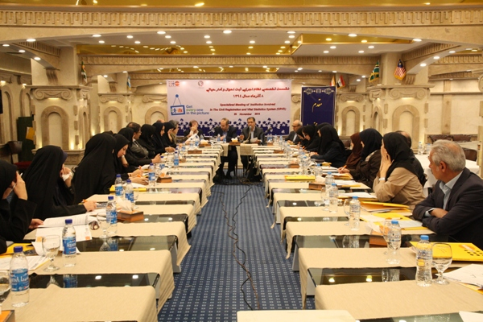
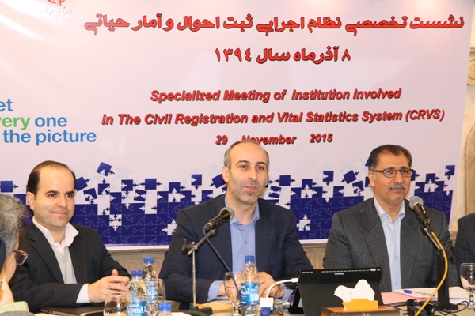
12 Goals and Strategies

Slide 11
There were also two UNFPA-sponsored research projects for a more detailed examination of the status of the death registration and a method for continuous evaluation of data.
The conductors of these research projects were two of the most prominent demographic professors in Iranian universities
And for the projects, the statistics of all stakeholders were used. In one of the plans, conversations were held with registrants in different regions of the country.

Slide 12
Time required to fill the report

Slide 13
After the initial meeting, which resulted in the initial completion of the questionnaire, representatives of each of the stakeholders took the necessary measures to comment on their organization's questionnaire. Finally, in a 6-month process, all comments were collected and the questionnaire was completed.

Slide 14
Validation with other agencies and ESCAP

Slide 15
All stages of the completion of the questionnaire were carried out in partnership with the United Nations and the World Health Organization, and two UNFPA-funded projects, as well as produced documents and reports published in the evaluation of the content of the questionnaire, were used.

Slide 16
Challenges encountered and how they were dealt with

Slide 17
The most important problem was the lack of standard knowledge of the basic concepts of CRVS. Especially topics like VERBAL Autopsy. some very useful training course was conducted with the support of the UNFPA, which unfortunately stopped and this is the most important challenge ahead.

Slide 18
Best practices in gathering necessary information and filling it out

Slide 19
In Iran, most of the data is needed through the National Population Database established in 1991 at the CRO. Iran's census has also been carried out every 5 years and its results are available. The Ministry of Health has also collected and provided a lot of data.

Slide 20
Completion of the questionnaire, however, will require the reorganization of the meetings to be taken into account by the formal stakeholder views.

Slide 21
Despite significant advances in the implementation of ICD10 in Iran, the continued improvement register of cause of death is the most important program in our country.

Slide 23
+98 912 899 3975 +98 21 6670 5959 Mohammad.b.abbasi@gmail.com
Thank you
for the opportunity giving to me

